Slide 1

High Efficiency Turbo Blower
December 10th, 2010

Slide 2
AGENDA
Overview
Core Technology
Certification
Installation flexibility
Advanced technologies
Performance
Maintenance
Comparison to other technologies
Energy savings
life cycle cost comparison

Slide 3
OVERVIEW
Product based on Aviation Gas Turbine engines
Highest number of installations in the US with 220 installed and 170 on order
  Majority of our customers are Districts and large Cities
Demonstrated Reliability and Energy Savings
  3 WEF WE&T case studies were published on our product
Recognized by customers as a highest quality product
  Built with best quality components and UL/CSA certified
APG-Neuros recognized for Excellent Customer Service
  Highly competent Service Engineers and Control Specialists
  Fully developed Service Network across US
  Parts available within US for delivery within 24 hours
  Life time extended warranty program

Slide 4
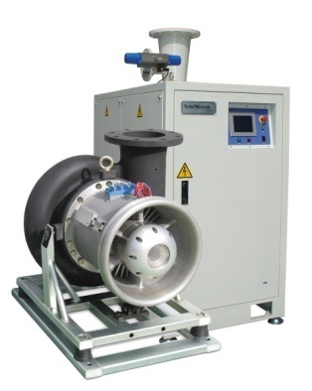
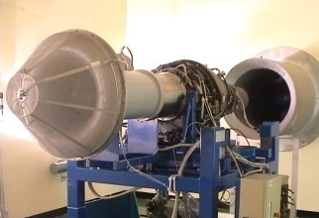
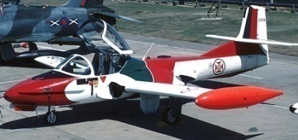
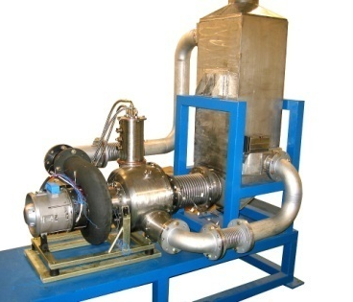
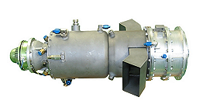
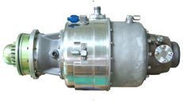
Overview
Technology
Technology Foundation in Aerospace & Defense
Industrial Turbo Machinery: Turbo Blower/Compressor, Turbo Refrigerator Gryocooler
Energy/Environment: Micro Gas Turbine for Combined Heat & Power
Aero Engines: Gas Turbine Engine for UAV
Military Aviation: F16 Program
APG-Neuros: Joint Company between Aviation & Power Group (APG) & Neuros

Slide 5
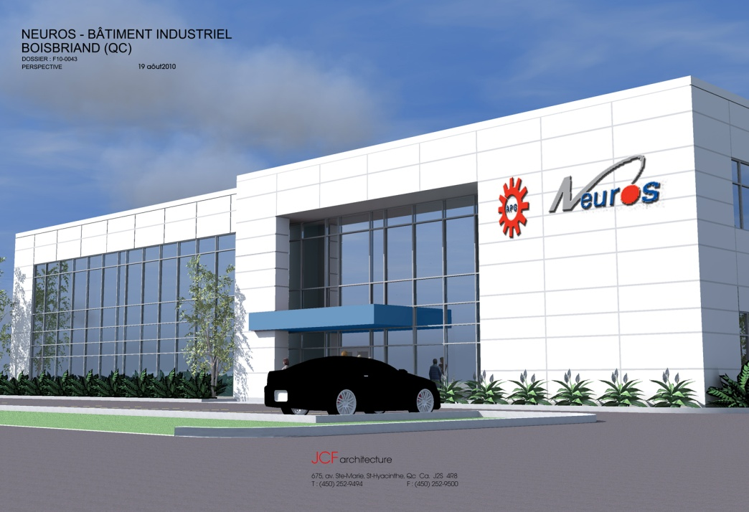
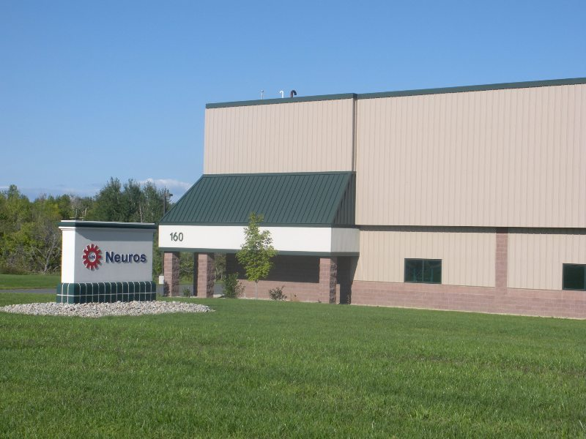
Overview
Headquarters and manufacturing
Plattsburgh, NY, USA
Blainville, QC, Canada

Slide 6
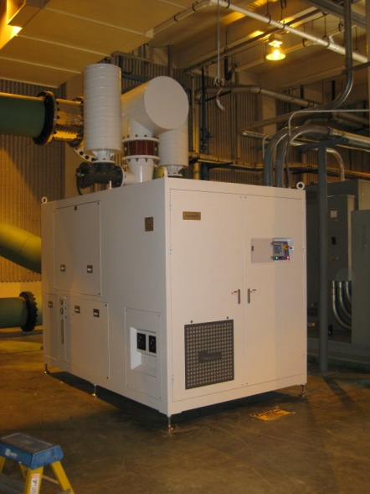
Core Technology
Technology developed in the Aerospace and
Defense Industry
Core Technologies:
  Air Bearing
      3^{rd.} Generation Bump Foil - high load and low power loss
  Aeronautic Flow Path & Aero Compressor
      Turbofan Gas Turbine engine layout - process is air bearing
      Forged Impeller machined with highest efficiency & durability
  Permanent Magnet Synchronous Motor
      High efficiency with low efficiency loss with speed turn down
      Combined with Sinus Filter for low heat generation (runs cool)
Dual Core Blower

Slide 7
Core Technology
High Frequency (Variable Frequency Driver) VFD
  High Efficiency and lowest heat generation
  Combined with Line Reactor for low power loss
Integrated PLC Advance Control
  Complete system to control blowers & control components
Single Core up to 350 HP & Dual Core up to 700 HP
  68 % Flow Turn Down with conserved efficiency
  Built in system redundancy

Slide 8
core technology
Complete Aeration System Control:
Additional efficiency optimization
  Product offers complete Aeration System Control
    Optimize efficiency and operational flexibility
  Operate Multiple blowers based on input command
    DO Control
    Pressure Control
    Flow Control
    Most Open Valve system

Slide 9
CORE TECHNOLOGIES
ADVANTAGES & Benefits
  More Robust and Higher Quality product
    Complete blower package UL & CSA certified
      Every component is UL listed
    Built with highest quality enclosure
    High Quality off the shelf High Quality components
    Assembled and tested in Plattsburgh, NY
  Saves Higher Energy consumption
    Demonstrated savings up to 35% compared to PD & Multi-stage
    Demonstrated savings up to 11% compared to other HS Blowers

Slide 10
CORE TECHOLOGIES
ADVANTAGES & Benefits
  Highest Availability & Lowest Maintenance cost
    Demonstrated 96.6% availability over 3 years at Moreno Valley. CA
    Only scheduled maintenance is cleaning / changing air filter
  Lowest installation cost
    No heat rejection to surroundings
    Fully integrated glycol cooling system & Harmonic Filter

Slide 11
Certification
Neuros’ Turbo Blower Package
Certifications
CSA – Canada/US
UL – US/Canada
CE - Europe

Slide 12
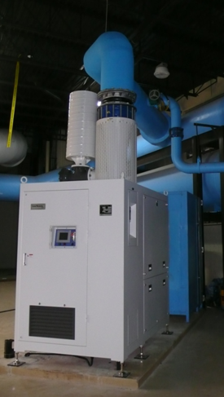
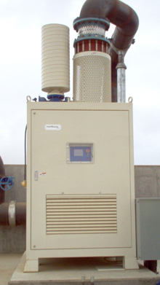
Installation Flexibility
Indoor or Outdoor under Canopy

Slide 13
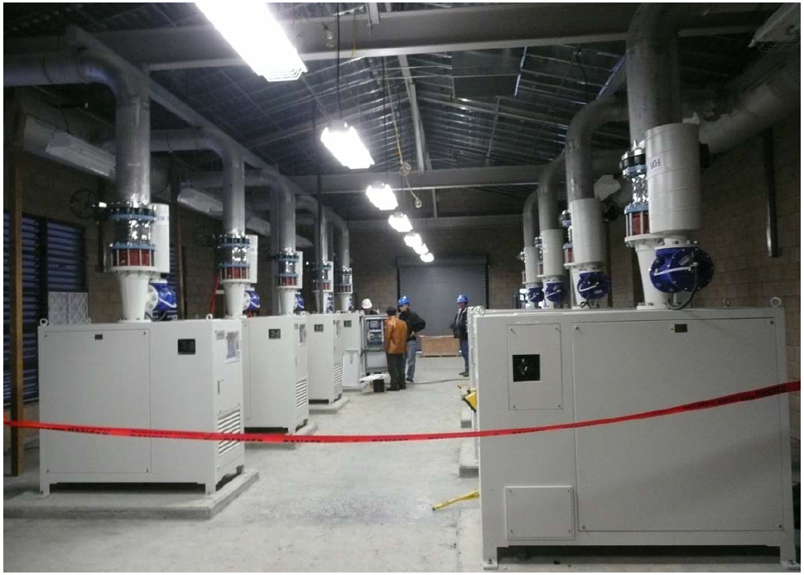
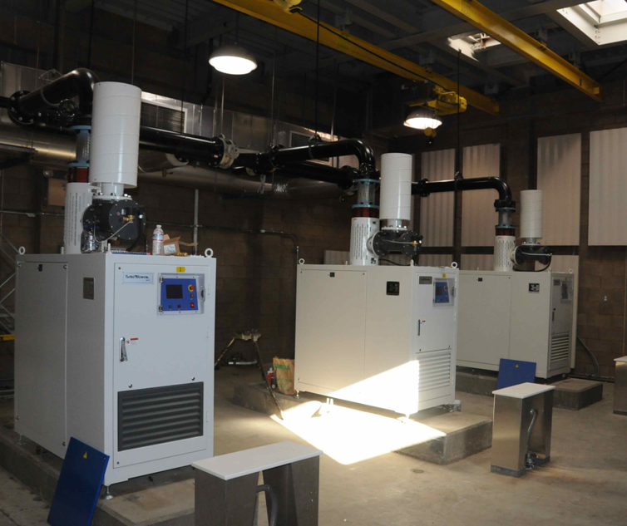
Installation Flexibility
Multiple Blowers installations
Hollister WWTP NX150 & NX100
Benicia WWTP NX75

Slide 14
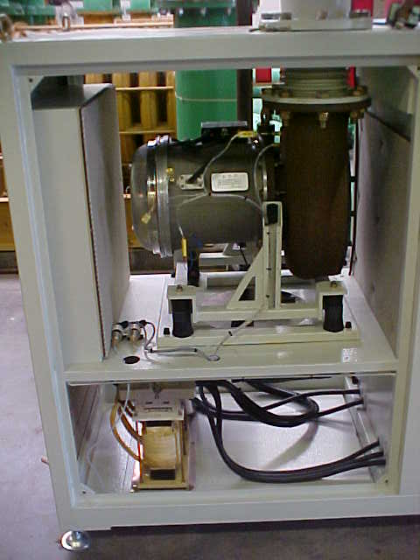
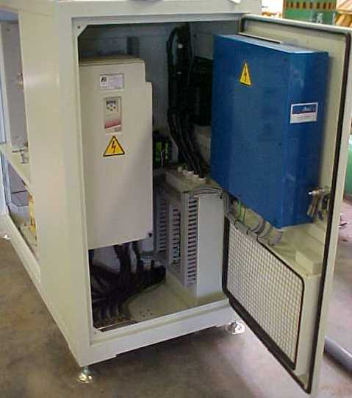
Installation Flexibility
Blower package and Built in
Control system
Blower Core
Includes PMSM
PLC
Options:
1. Allen Bradley
2. GE
3. Siemens
4. Cimon
5. Schneider
Line Reactor
&
Sinus Filter
Adjustable
Feet
VFD
By KEB America
Low heat generation
High Efficiency

Slide 15
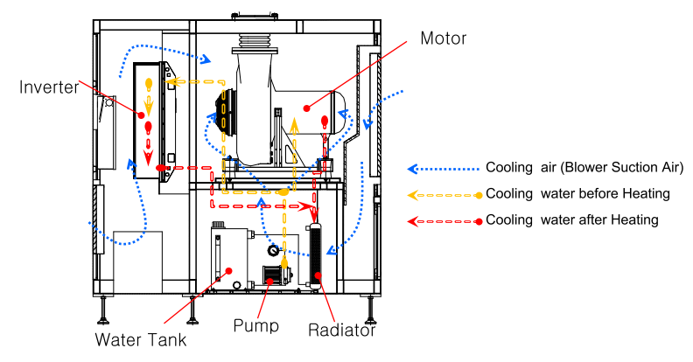
Advanced Technology
Integrated Cooling System
No Heat Rejection outside Blower enclosure

Slide 16
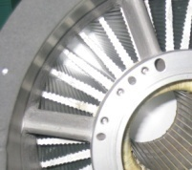
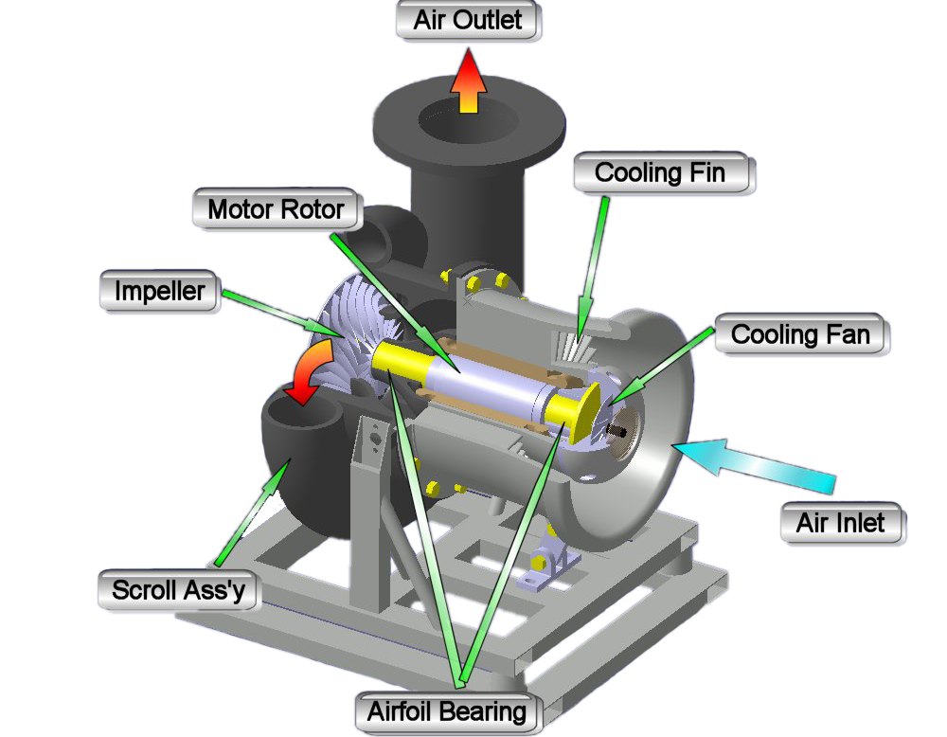
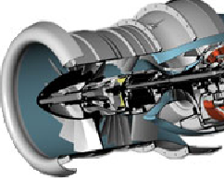

Advanced technologies
Turbo Blower Core
Layout Based on Aero Gas Turbine Design

Slide 17
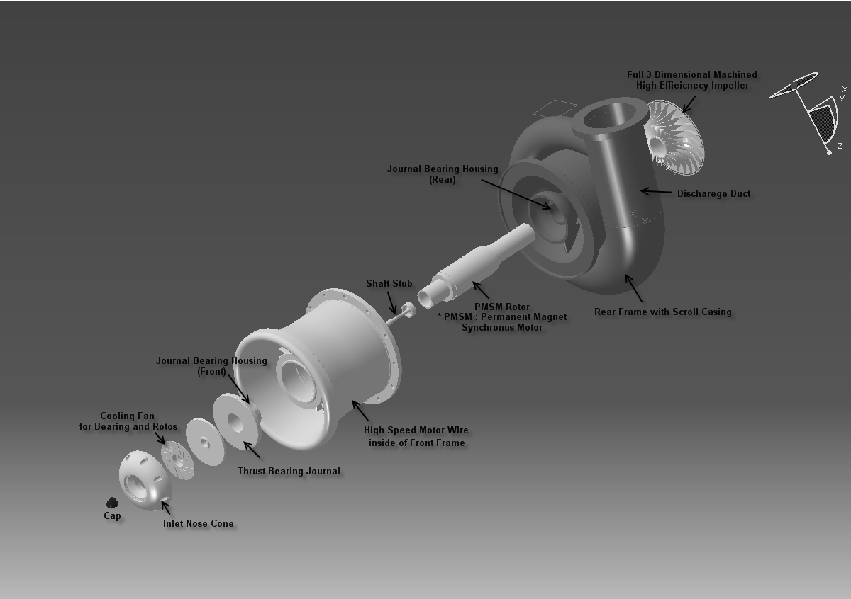
Advanced technologies
Turbo Blower Core
Non-contact, Single Motor, Rotor, Impeller

Slide 18
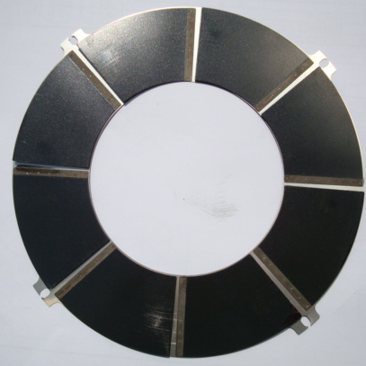

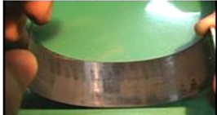
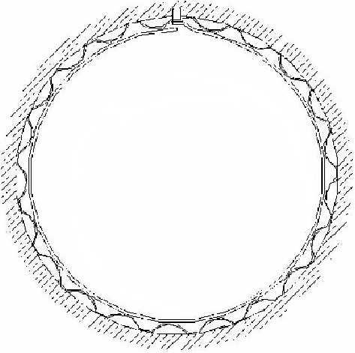
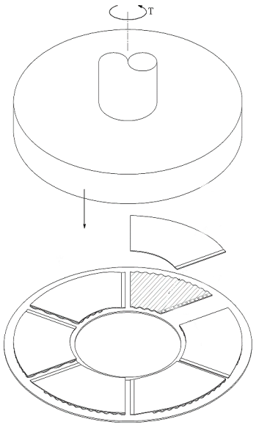

Advanced technologies
Air & Bump Foil Bearing
Thrust Bearing
Journal Air Bearing
Bump Foil
Liner
High Speed Rotation
Pressurized Air
by Hydrodynamics
Nearly 20μm

Slide 19
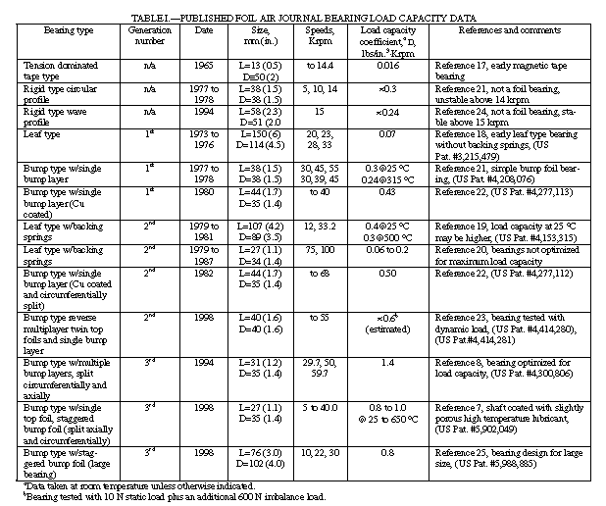
Advanced technologies
Bump Foil Air Bearing
Provides Higher rotor load carrying capacity
Leaf Type Bearing 1st Generation
Bump Foil Bearing 3rd Generation
1994 to 1998
1973 to 1976

Slide 20
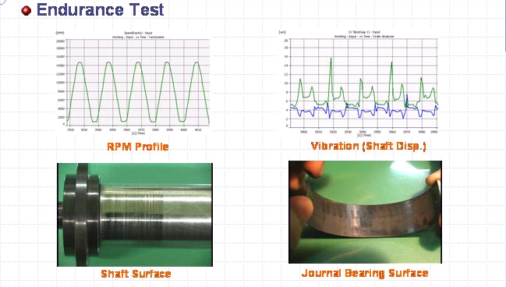
Advanced technologies
Bump Air Foil Bearing
Durability demonstrated through 25000 starts
Endurance Test
NO Damage
NO Damage

Slide 21
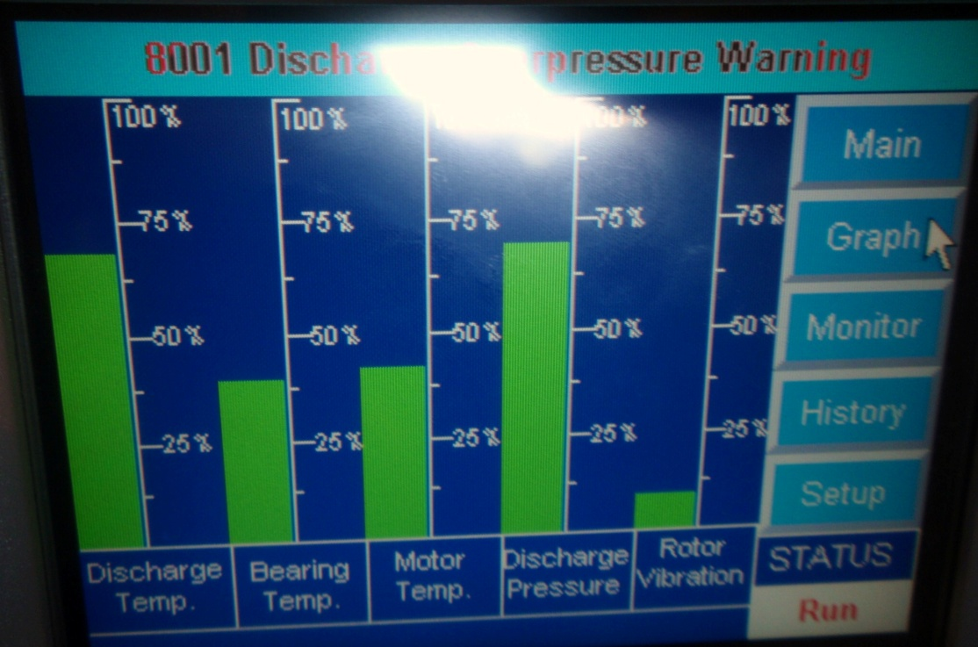
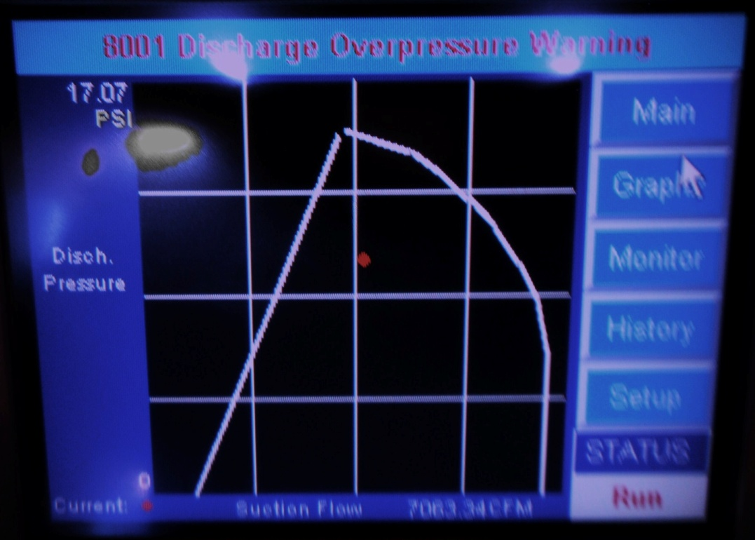
Advanced technologies
Smart Control – Advance Technology PLC
Control, Monitor & diagnostics
NX Turbo Blower Monitoring
Live Perf. Curve
NX Turbo Blower Monitoring
Limit Bar Graph

Slide 22
                Advanced technologies
                Dual Core Drivers for Technological development
Concept is applied in Helicopter Gas Turbine Engines
  Bell 412, Sikorsky B-36, Boeing B47, Agusta US 101
300 HP is currently the practical size limit
  PMSM with single impeller supported by air bearing
Dual Core is a better option than using dual impellers design
  Provides higher capacity with higher flow turn down
Higher power single shaft rotor poses risk
  Burning of heavy rotor at high speed
Dual Core provides built in system redundancy
  One Core continues to operate with other Core out of service

Slide 23
Advanced technologies
Dual Core advantages
Component | Dual Core | Single Core | Remarks
Number of Cores | 2 | 1 | Single Impeller in each core
Flow Turndown | 65 to 70% | 45-50% | With Single Mode Operation
Operation | Single/Dual | Single | Offer wider turn down range and flexibility
Redundancy | YES | NO | 50% of the Capacity for the Redundancy
Maximum Package Efficiency | 74-75% | 73-75% | 2% of pressure drop at the head with the Dual Core package
Number of Power Cables | 4 | 4 | 3 (phase) + 1 (ground)
Number of VFD | 2 | 1 | VFD: Variable Frequency Driver
Number of LCP and OIT | 1 | 1 | LCP: Local Control Panel, OIT: Operator Interface Terminal
Cooling System | 2 | 1 | Two independent Glycol cooling systems for the redundancy
Maintenance | Low (1) | Low (1) | No maintenance for the core is required
Weight | Light | Light | Dual Core is expected to have 30% heavier weight than single core

Slide 24
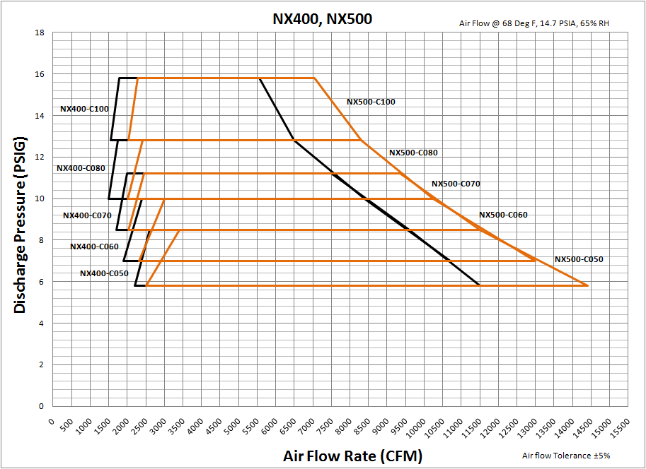
performance
Flow Turn Down range: 100% to 22% at constant Discharge pressure

Slide 25
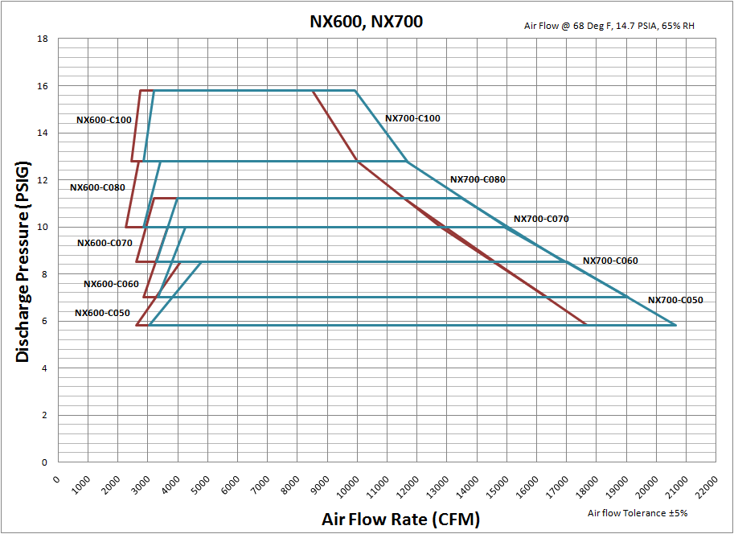
performance
Flow Turn Down range: 100% to 22% at constant Discharge pressure

Slide 26
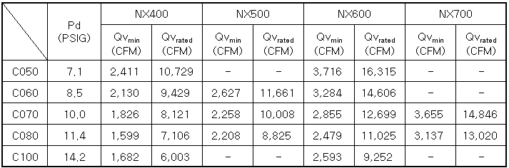
Performance
Dual Core performance
NX400 - NX700
Ambient conditions : 68 F, 14.7 PSIA, 65%RH
Single PLC, dual core & dual VFD
Operation mode
  Auto speed mode core selectable (single/dual core)
  Auto pressure, flow rate, and DO mode
  core automatically go on/off (single/dual core)

Slide 27
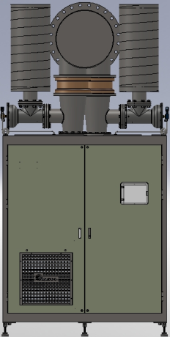
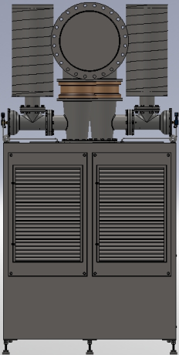
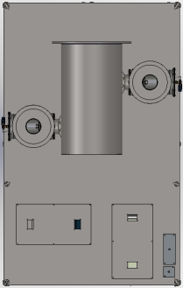
Performance
Enclosure II
Upper, front & rear side:
front side
rear side
upper side
header
header
BOV
(by pass
valve)
cooling air inlet of electrical room
touch screen
Inlet of suction air

Slide 28
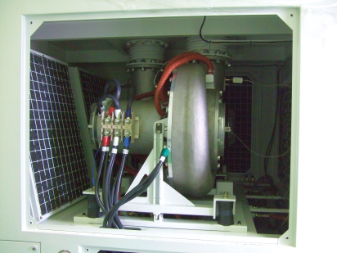
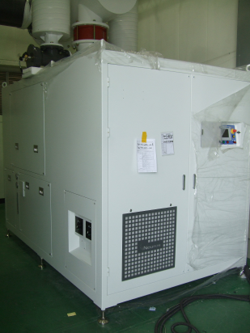
performance photos of core and exterior
Core
Enclosure
header
inlet of cooling Glycol
PLC Touch
screen
level gage of glycol cooling
impeller/diffuser/Scroll
core
motor
circuit breaker (MCCB)
power inlet from lower side
cooling air inlet to Control section

Slide 29
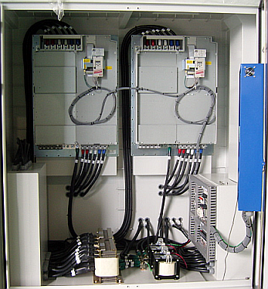
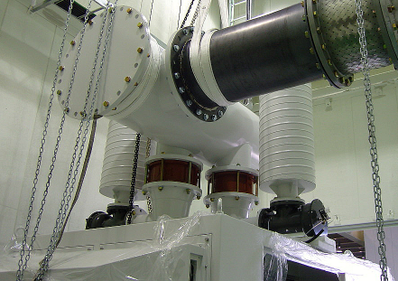
performance controller & bov
Electrical & control section
Header & BOV
VFD
control box
BOV
(by pass valve)
header
discharge cone
check valve

Slide 30
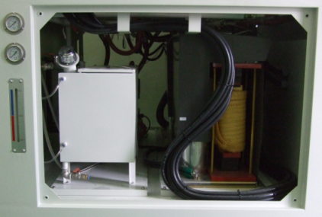
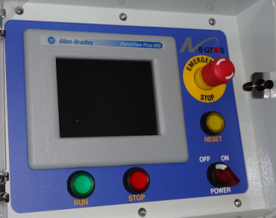
performance cooling unit and controller
Cooling unit
Controller
tank of cooling water
touch screen
emergency button
fault reset button
level gage of cooling water
run button
stop button
power on/off switch

Slide 31
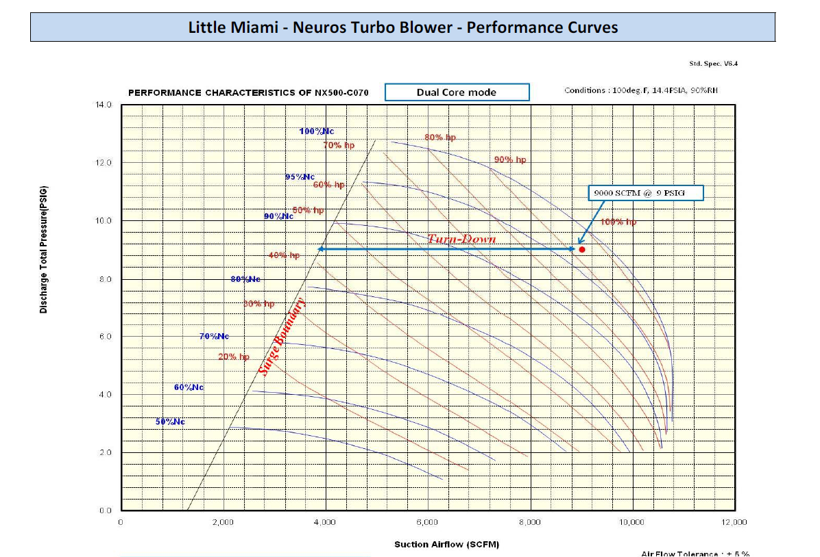
performanceDual Core Model Performance
68% Flow Turn Down at Constant pressure
Ambient conditions : 68degF, 65%RH, 14.7PSIA

Slide 32
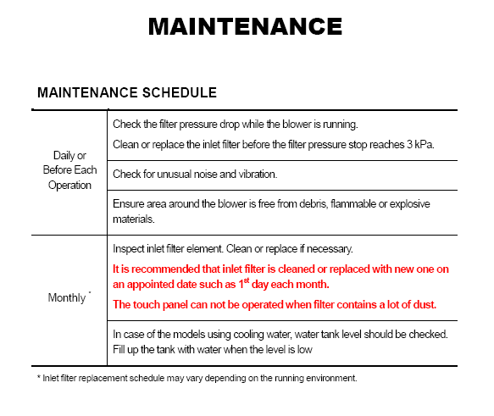
maintenance
No special Tools or skilled labor required

Slide 33
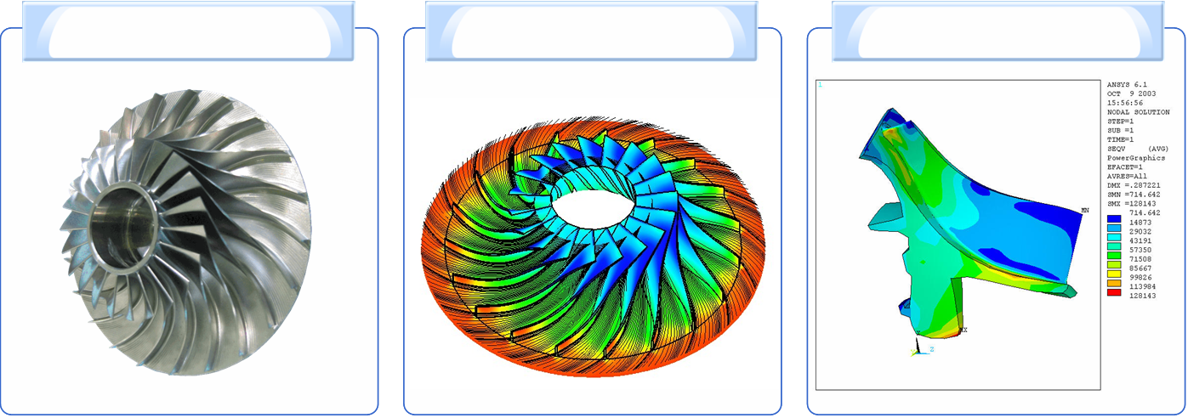
MAINTENANCE
IMPELLER DESIGN
Material:
Forged - Al Alloy, SUS (option), Titanium (option)
Design:
Designed using in-house software based on aero gas turbine engine technology
Applies core technology obtained by National Research Laboratory (NRL)
Impeller of NX Series
Static Pressure
Distribution of Impeller
Vibration Analysis
of NX Series

Slide 34
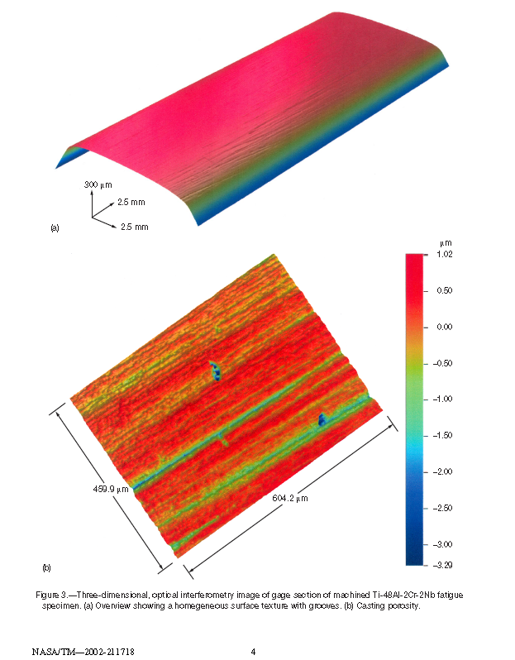
Forged Material
Cross-section
Cast Material
Source: NASA

Slide 35
Impeller Advantages
 | Forged | Cast | Remarks
Type | SUS 630 Aluminum 7075 Titanium | SUS 630 | Neuros: Anti-corrosion, anti-explosion available
Mfg. | Machined Forging (5-axis NC Machining) | Casting (Lost Wax) | Neuros has selected 5-axis machining for better higher efficiency & better quality, at higher manufacturing cost.
 | Strength Machining > Casting Precision Machining > Casting Quality (Life) Machining > Casting
Eff. | 84% - 76% Depending on Impeller Size | 78% - 72% | NEUROS > by 6-8%
 | 1% gain (Neuros) Machining > Casting 1%~5% gain (Neuros) Specific speed: 0.7-0.8 vs. 0.9-1.1
RPM | 17,000 - 32,000 | 30,000 - 40,000 | Neuros larger impeller diameter “from forging” allows lower speed operation for higher efficiency

Slide 36
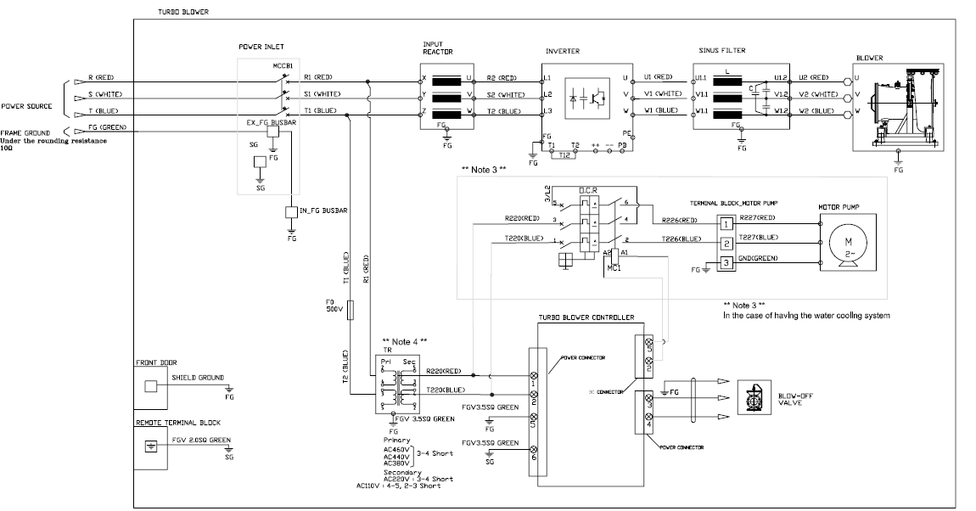
Turbo Blower
Optimized Electrical System
System Treatment to Prevent heat generation and maintain high efficiency

Slide 37
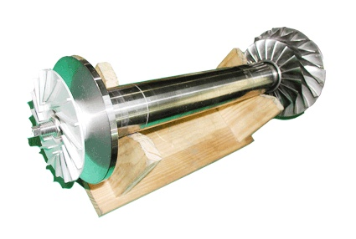
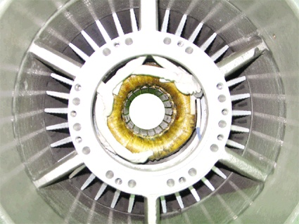
Permanent Magnet Synchronous Motor
Characteristics of motor for turbo machineries
  High speed : 20,000 - 100,000 RPM
  Range : 50 - 500 hp
  Need an inverter for high speed motor
PM Rotor
Stator and Cooling Fin Assembly

Slide 38
Permanent Magnet Synchronous Motor
Motor rotates in harmony with incoming power signal; therefore it runs cooler
Shaft has internal permanent magnet to transfer EMF to load, rather than windings and slip rings.
No physical contact between stator and shaft
Very efficient design
Offers excellent speed control

Slide 39
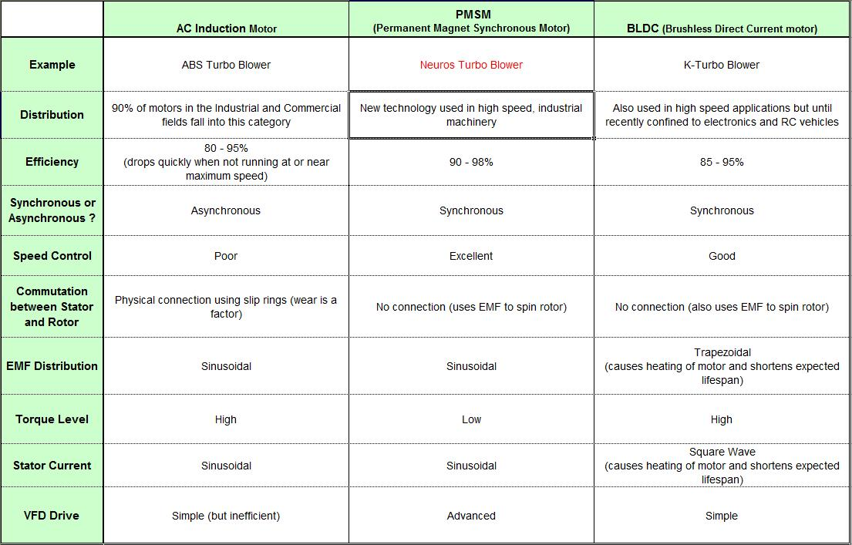
Comparison to other technologies
High Speed Motors Comparison
A

Slide 40
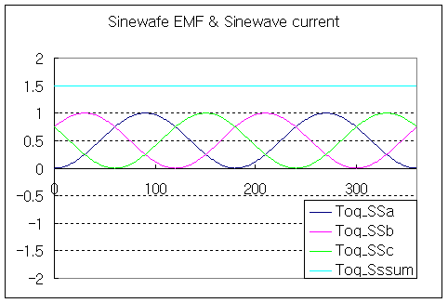
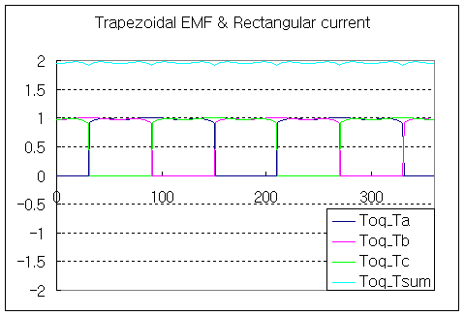


Comparison to other technologies Permanent Synchronous Motor Advantages
Lower heat generation and smoother operation
PMSM
Phase Difference =0 deg.
Other type
Phase Difference =30 deg.

Slide 41


Energy savings
Power Consumption Savings

Slide 42


Energy savings
Power Consumption savings

Slide 43


Life Cycle Cost Savings
Lakehaven, WA NX300
 | Average kW | #of Blowers | kWh/yr | Costs | Savings
350 HP PD and Channel Blowers | 267.3 | 3 | 2,341,804 | $175,635.0
Neuros Blower | 152 | 1 | 1,331,520 | $99,864.0 | $75,771.00
Neuros demand reduction savings |  |  | 115 (per billing cycle) | @$8/kWh | $11,040.00
Neuros projected usage per year. | 200.3 | 3 |  | $136,224.00
Total Actual savings | 152 | 1 |  |  | $86,811.00

Slide 44

Customer Testimonials
Everyone is very happy with the performance of your unit.
The smoothness and quietness of the unit astounds everyone
that sees it. We have informed
our leadership of the unit so the word can be spread to other
locations for potential future
projects.
Michael Born, Neenah Nonwovens Facility, Kimberly-Clark Corp.
Dual Core NX500-C100 Installation

Slide 45

Customer Testimonials
I want to tell you that I was very impressed with the facility in Plattsburgh, and that you have assembled an excellent staff at that location. Although there were a couple glitches during the testing, overall I thought the PTC-10 and functional tests of the blowers went very well. I’m looking forward to having them installed and running in the plant, and expect to have may years of trouble free aeration.
Thank you very much for all your assistance over the last few weeks.
Harry P. Butland, Marlborough West Plant
NX75-C060 (2) & NX100-C060 (2) Installation

Slide 46
Summary
Our Distinctions
Our product is based on Aviation Gas Turbine engines
Highest experience in US with 210 units installed
  Majority of our customers are Districts and large Cities
Demonstrated Reliability and Energy Savings
  3 WEF WE&T case studies were published on our product
Customers recognize our product as Highest Quality
  Built with best quality components and certified to UL and CSA
Customers recognize our Excellent Customer Service
  Highly competent Service Engineers and Control Specialists
  Fully developed Service Network across US
  Parts available within US for delivery within 24 hours
  Life time extended warranty program

