Slide 1
Pall Ultrafiltration Technology in Water Filtration

Slide 2




Water Quality Platform
The Complete Water Cycle Solution
Distribution
Consumer
Source Water
Drinking Water Plant
Wastewater Collection
Wastewater Treatment
Industrial
Environment
Complete water Cycle solutions

Slide 3
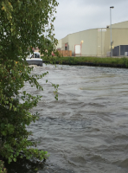
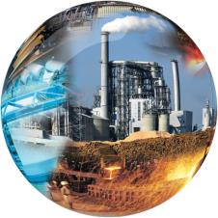
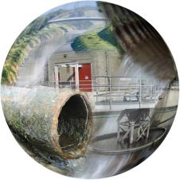
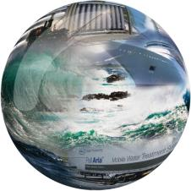
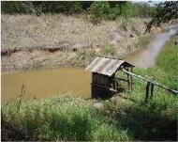
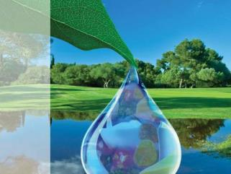
Applications
Surface Water
Wastewater
Seawater

Slide 4
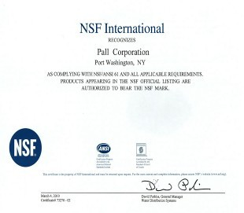
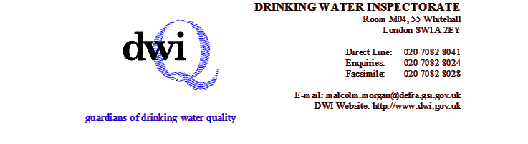



Global Certifications
© Copyright 2009, Pall Corporation. Pall, , Pall Aria, Claris, Nexis, and Ultipleat are trademarks of Pall Corporation.
® Indicates a trademark registered in the USA. is a service mark of Pall Corporation.

Slide 5
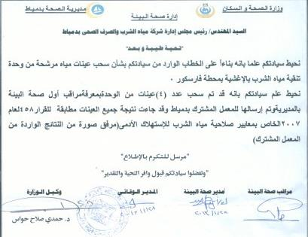
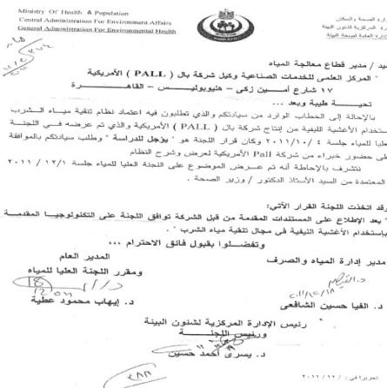
        Local Certifications
Pall solutions are Locally Certified

Slide 6
Membrane Filtration vs Conventional Filtration

Slide 7

Membrane Filtration vs Conventional Filtration
Granular Media
  Irregular Pore Size Distribution (50 -70 micron between grains)
  Probable Filtration
Membrane Media
  Controlled Pore Size Distribution (0.1 micron)
  Absolute Filtration
Membrane technology is Absolute Filtration

Slide 8






One Step Solution …Hollow Fibre Membranes
Conventional
Membranes
Organic Matter
Clarification
Turbidity
Sand Filter
Settling Tank – 2nd Stage Filter
Storage Polishing
Coagulant
&
Polymer
Coagulant
&
Polymer
Membranes are one step Filtration

Slide 9
NO Feed Coagulant
No coagulation required
FeCl3 or other coagulants are not required to operate Pall membranes in a stable mode.
FeCl3 is not used to boost flux.
Proven experience in operating membrane systems at high flux without coagulation.
No Coagulation, No feed Chemicals injection

Slide 10
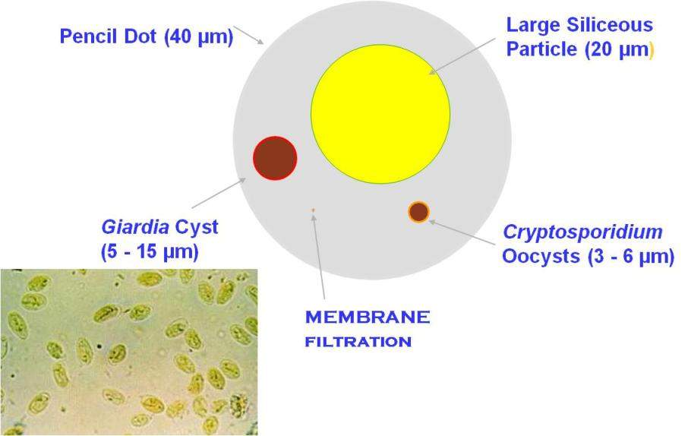
Relative Sizes of Small Particles
Notes:
10

Slide 11
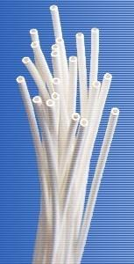
Outside – inside Filtration
Permeate water
Concentrated water
Permeate water
Raw water
Outside In Filtration
Inside Out Filtration
Hollow Fiber
Pall

Slide 12
Membrane Filtration vs Conventional Filtration
Compact Layouts

Slide 13
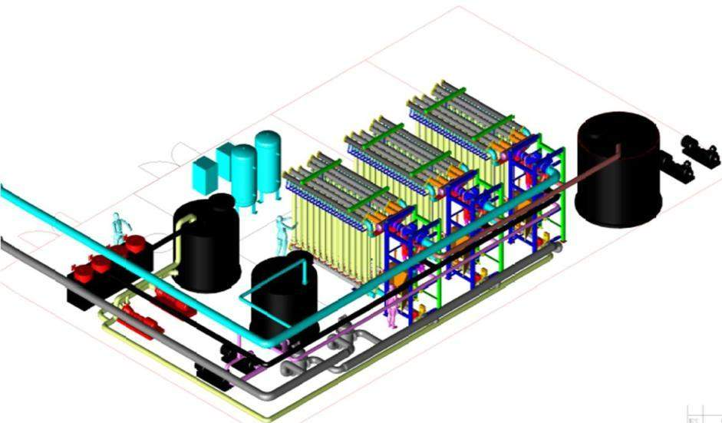
Compact layouts, typical for 750 m³/hr
3 x 250 m³/hr “18,000 m3/d”
Dimensions:
15 m x 12 m
Air Blower/ Compressor with receiver
Backwash tank with pumps
NaOCl / Caustic cleaning tank
Module racks & Valve racks
Acid cleaning tank

Slide 14
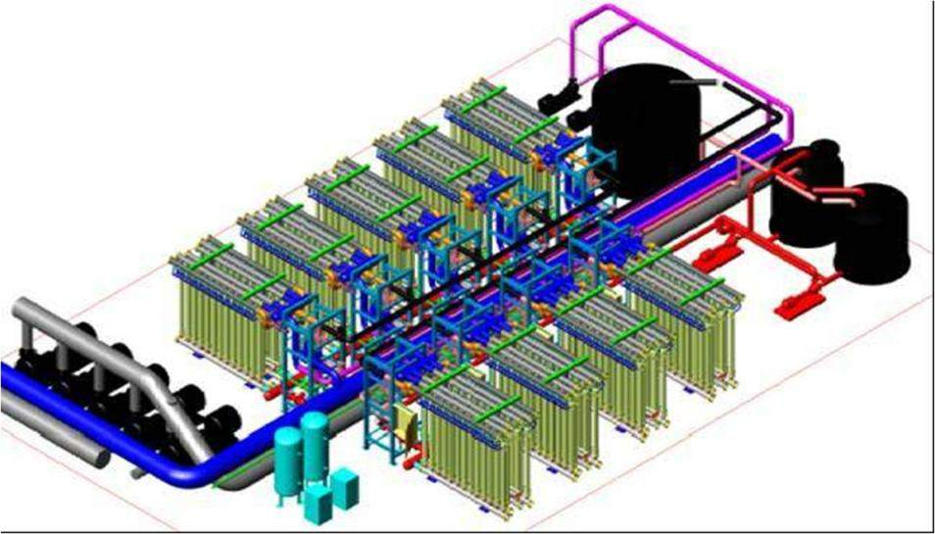
100,000 m3/day layout system
Dimensions:
35 m x 30 m (approx.)

Slide 15
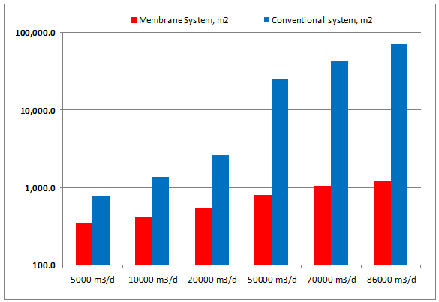
Foot Print, Membranes vs Conventional
Compact, Smallest Foot Print

Slide 16
PALL Products & Systems

Slide 17
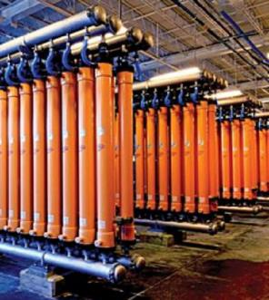

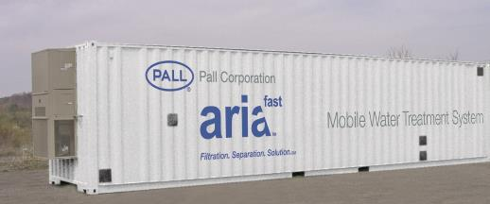
Pall — Filtration, Separation, and Purification
Providing filtration, separation, and purification solutions for all fluid management needs.
Notes:
(To shorten presentation, can cut all single-OpCo-specific slides and just use overview slide – Slide 16.)
Pall’s water processing technology platform leverages core technologies, such as highly permeable hollow-fiber microfiltration membranes, to meet their customer’s varied and vast needs.
Image needs to be approved (Stock Image) or replace with alternative

Slide 18
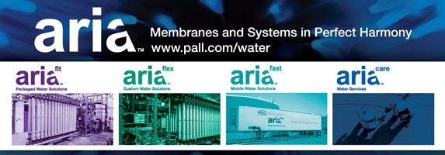
Pall Products & Systems
Landbased systems
AriaFit
AriaFlex
AriaFast
AriaCare
250 – 50 000 m³/h
Flexible systems
Services
for all Aria Water treatment systems
0 – 450 m³/h
Packaged systems
0 – multiple 200 m³/h
Flexible mobile systems
Meets all range of capacities

Slide 19

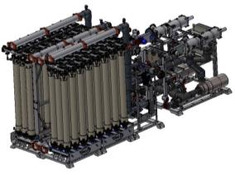
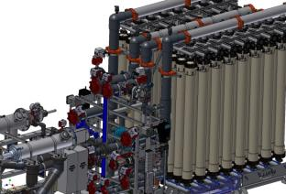
Introducing
Flexible:
  Custom configured design for 5 m³/hr to 450 m³/hr
  Accommodates unique or existing space requirements
  Ease of expandability and upgrades
Intelligent:
  Smart diagnostics with intuitive operator dashboard enables easy system operation and optimization
  Pre-engineered, factory tested system modules ensures fast, problem free installation
Trustworthy:
  Processing over 1.5 Billion Gallons of water every day
  Over 15 years of operation experience and 2500 years of combined systems operation

Slide 20
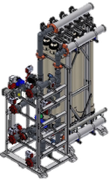
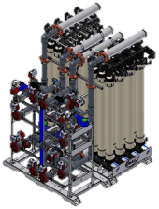
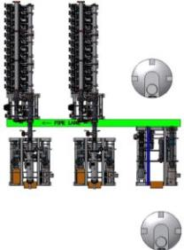
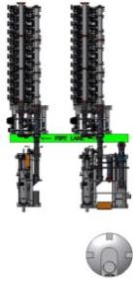
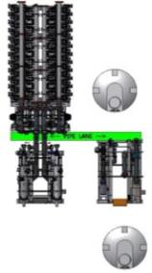
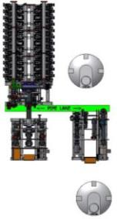

AriaFit
Fits in all layouts

Slide 21
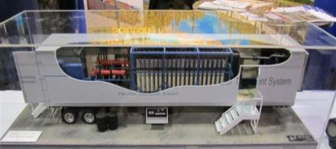
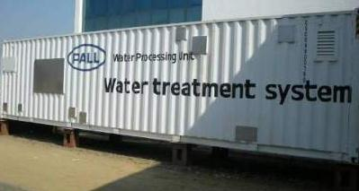
Containerized Systems
  Pall Containerized units for medium Communities
Pall has developed the container systems to match the medium capacity requirement “60 l/s”
The required space for the unit is only 12m x 3m “40 f”
The delivery time of the unit is only 60 -100 days
Pall container system capacity 60 lit/sec

Slide 22
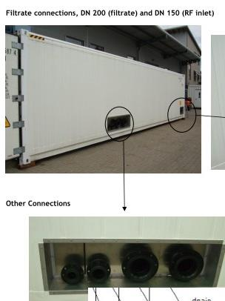
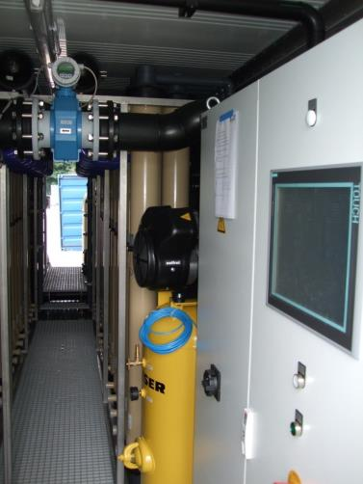
Inside and Outside the container

Slide 23
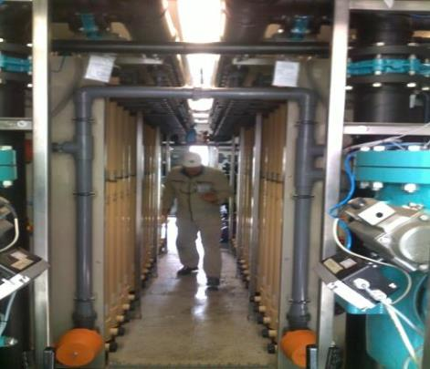
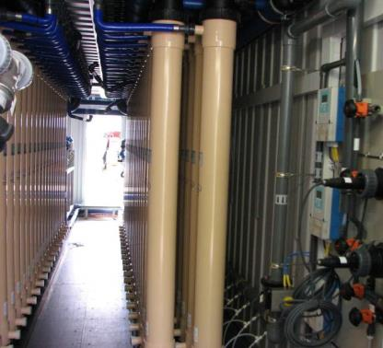
Inside and Outside the container

Slide 24
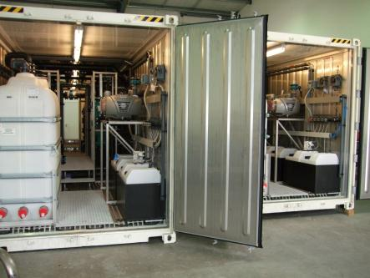
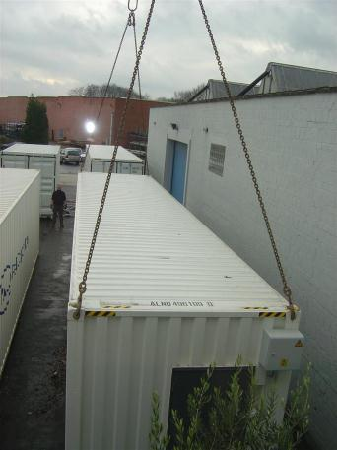
Inside and Outside the container

Slide 25
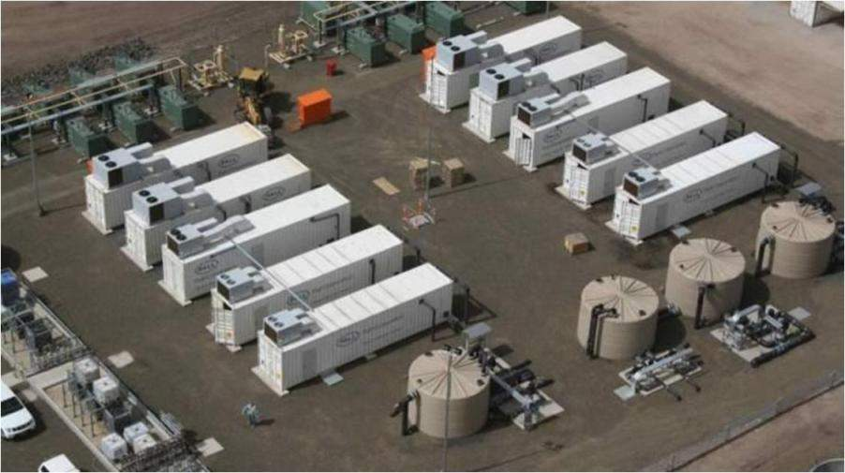
Containerized Systems

Slide 26
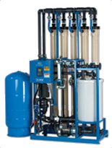
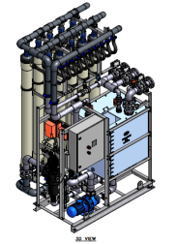
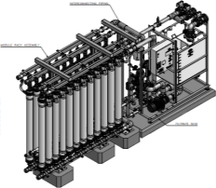
Small Capacity Units
 | Aria – AX 2 Unit | Aria – AX3 Unit | Ara- AX4 Unit
Capacity Ranges | Up to 200 m3/day | 200 - 500 m3/day | 500 – 1000 m3/day
Dimensions | 1.2 m x 1.2 m x 3.5 m | 1.8m x 1.6 m x 3.5m | 6.3 m x 1.5 m x 3.5 m
Aria AX-2
Aria AX-3
Aria AX-4

Slide 27
Pall UF membranes, How it work?

Slide 28
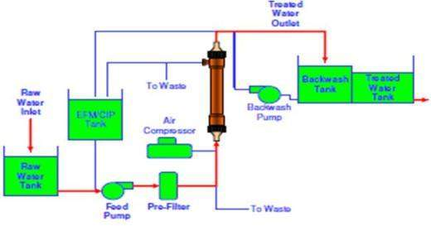
FILTRATION
Treated
Water Outlet
Filtration
From the outside to the inside
From lower head to upper head
Raw
Water Inlet

Slide 29


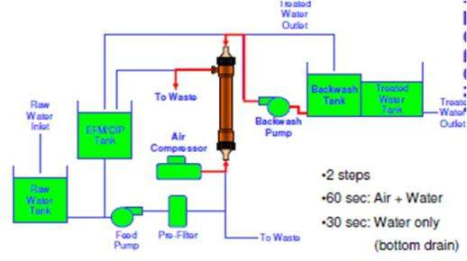
BACKWASH
Treated
Water
Inlet
Unique backwash
with water and air
followed by backwash with water
Reduced Wastewater Volumes
Wastewater Outlet
Air Inlet

Slide 30
ENHANCED FLUX MAINTENANCE (EFM) and CLEANING IN PLACE (CIP)
Short Duration Cleaning (EFM)
  Less than 40 minutes
  No detergents
  Easy to discharge
  Reduced wastewater volumes
  Typically Once every 1-2 days
Solution Outlet
Long Duration Cleaning (CIP)
  Less than 4 hrs
  Standard Acid and Alkali
  Can be neutralized
  Typically Once every 6 - 9 months
Solution Inlet

Slide 31
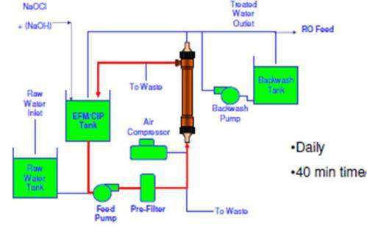
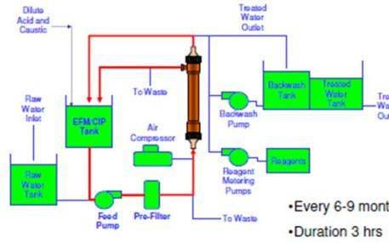
SHORT AND LONG DURATION CLEANS
Short Duration Cleaning (EFM)
  Less than 40 minutes
  No detergents
  Easy to discharge
  Reduced wastewater volumes
  Typically Once every 1-2 days
Long Duration Cleaning (CIP)
  Less than 4 hrs
  Standard Acid and Alkali
  Can be neutralized
  Typically Once every 6 - 9 months

Slide 32
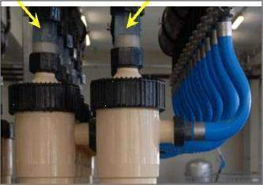
INTEGRITY TEST
Transparent Tube
Integrity Test
Automatic Pressure Decay Test
Visual Detection
Less than 5 minutes
Transparent Tube
In case of breakage, individual fibre can be identified.
Repair with pin
Air
Inlet

Slide 33
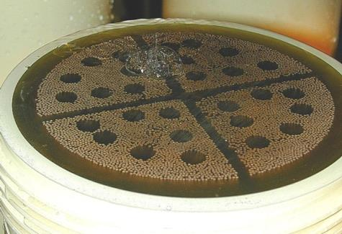
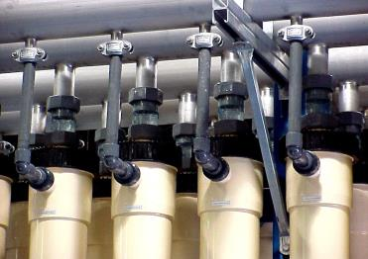
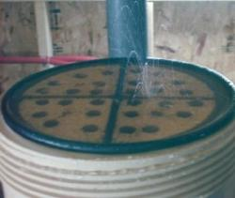
Setting the standard – Membrane Integrity
Integrity Testing.
Do not be afraid to use the right (higher) air pressures
Simple and Easy to use automatic procedure. Easy detection via transparent coupling
!

Slide 34
Pilots & Case Studies in Egypt

Slide 35
Pall Success Story in Egypt
Pall’s trials in Egypt
Year | Client | Location | Raw Water Source | Contact Person
2010 | Alexandria Water Co. | Manshia Plant | Mahmodia Canal | Eng. Nadia Abdu - Chairman
2010 | Suez Canal Authority | Suez | Ismailia Canal | Eng. Nageh Gad Al Haq- Utilities Manager
2011 | Qena Water Co. | Rawateb | Nile Water | Eng. Mohammed Ali - Chairman
2011 | Qena Water Co. | Rawateb | Well Water “Fe & Mn removal” | Eng. Mohammed Ali - Chairman
2011 | Giza Water Co. | Baharia Oasis | Well Water “Fe & Mn removal” | Eng. Amr El Wahsh - Chairman
2012 | Red Sea Water Co. | Marsa Alaam | Sea Water | Eng. Khaled El Morshid Water Desalination Consultant – Holding Company for Water and Waste Water
2012 | Damietta Water Co. | Fraskour | Nile Water | Eng. Saied Rabie - Chairman
2013 | Alexandria Water Co. | Siouf | SF backwash water | Eng. Nasra Noor Al Dein – Vice CEO

Slide 36
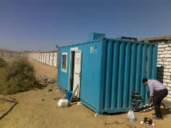
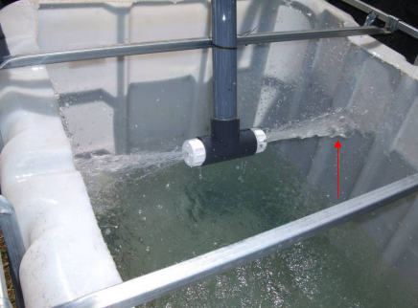
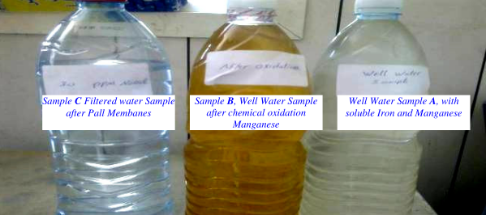
                Pall Trail at Oasis – Giza
This trail had been performed at November 2011 on well water for removing the Iron and manganese from the raw water , By using oxidation upstream of Pall unit by aeration and sodium hypochlorite solution , Pall succeeded to produce high quality drinkable water without Fe or Mn.
Pall Unit at Oasis – Giza

Slide 37
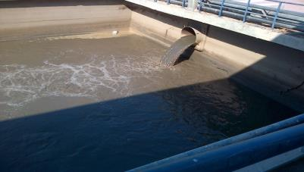
Suiof Water Treatment Plant – Suiof Area , Alexandria
Raw Water Source : Mahmoudia Canal
Design Capacity : 700,000-720,000 m³/d
Product Capacity : 650,000 m³/d
Waste Water : 50,000 – 70,000 m³/d
Waste Water Analysis
    COD: 60 – 70 mg/l
    NTU: 100 - 410 NTU
    Avg wastewater : 50,000-70,000 m³/d
    Possible Recycling rate: 80 - 88 %
Difficult Conditions:
High TSS loading
High Turbidity
High fouling contamination
High COD

Slide 38
Plant Scheme
Additional capacity added
TW Tanks
650,000 m³/d
692,000 m³/d
River water
700,000 m³/d
Clarifiers
Sand Filters
Backwash water
10,000 m³/d
Backwash water
40,000 m³/d
42,000 m³/d
Membrane
Filtration
Waste Collecting Tank
50,000 m³/d
Pall Solution
Concentrated slurry: 8,000 m³/d
Total waste: 50,000 m³/d → reduced to < 10,000 m³/d
i.e. < 2% of 700,000 m³/d

Slide 39


Backwash Water
(mixed in Collecting Tank )

Slide 40




BW Waste Water from the conventional plant
= FEED TO PALL UNIT
Filtered Water
=PALL UNIT OUTLET

Slide 41




Suiof Plant Lab. Result’s after 1st Sample:
Inlet Turbidity for Pall Unit 240- 410 NTU
Outlet Turbidity from Pall Unit 0.03- 0.1 NTU

Slide 42
PALL References in Egypt

Slide 43
Pall References in Egypt
Plant | Location | Capacity
Al Zouhor Water Treatment Plant | Alexandria | 60 l/sec - Plant
Ibrahimia Water Treatment Plant | Sharqia | 120 l/sec - 2containers
Bani Soeif Watre Treatment Plant | Bani Soif | 120 l/sec - 2 containers
Luxor Water Treatment Plant | Luxor | 120 l/sec - 2 containers
TelRak Water Treatment Plant | Sharquia | 300 l/sec - Plant
Farshoot Water Treatment Plant | Qena | 400 l/sec - Plant
Al Khosos | Army | 120 l/sec - Plant
New Orders - Under construction:-
Plant | Location | Capacity
GAMASA WTP | Daqahlia | 60 l/sec - Container
Rahmania WTP | Kafr Al Dawar | 60 l/sec - Container
Al Maged WTP | Bani Soif | 60 l/sec - Container
Hegaza | Qena | 60 l/sec - Container

Slide 44


Application:- Drinking Water Customer name:- NOPWSD
Capacity:- 10,000 m3/d Location:- Ibrahimia , Sharqia ,
Raw Water Source : Nile Water
Plant capacity : 10,000 m³/d
Commissioned : October 2015
Municipal Drinking Water

Slide 45

Application:- Drinking Water Customer name:- NOPWSD
Capacity:- 10,000 m3/d Location:- Bani Swaif , Egypt
Raw Water Source : Nile Water
Plant capacity : 10,000 m³/d
Year of Installation and commissioning
    July 2016
Municipal Drinking Water

Slide 46

Application:- Drinking Water Customer name:- AWC
Capacity:- 5,500 m3/d Location:- Alexandria , Egypt
Raw Water Source : Al Nasr Canal
Plant capacity : 5,500 m³/d
Year of Installation and commissioning
    August 2011
Municipal Drinking Water

Slide 47

Application:- Drinking Water Customer name:- Egyptian Army
Capacity:- 1,200 m3/d Location:- Cairo , Egypt
Raw Water Source : Nile Water
Plant capacity : 1,200 m³/d
Year of Installation and commissioning
    January 2013
Municipal Drinking Water

Slide 48

Application:- Power Plant Customer name:- Veolia WS
Capacity:- 20,160 m3/d Location:- Assuit , Egypt
Raw Water Source : Nile Water
Plant capacity : 20,160 m³/d
Year of Installation and commissioning
    October 2015
Boiler Feed Water

Slide 49

Application:- Zero Liquid Discharge Customer name:- ENNPI
Capacity:- 33,600 m3/d Location:- Eythidco , Alex , Egypt
Raw Water Source : Al Nasr Canal
Plant capacity : 33,600 m³/d
Year of Installation and commissioning
    November 2012
ZLD , RO pre treatment for zero liquid
Discharge plant

Slide 50




Questions
Thank you

