Slide 1
Iron and manganese removal from groundwater
Eng. Massoud Dango
Dr. Mohamed A. El-Behlil
Chemical engineering department Tripoli university

Slide 2
Presentation outline
Background (Formation and Impact of Fe and Mn)
Objectives
Treatment methods for Fe and Mn removal
Fe and Mn concentrations in GW
Propose a treatment system for Fe and Mn removal
Oxidation reactions involved in the aeration
Important design parameters
Results
Conclusions and recommendations

Slide 3
Background
(Formation and Impact of Fe and Mn)
Iron and Manganese Removal; Overview
Iron and Manganese are natural constituents of soil
and rocks.
Usually natural waters have an iron content which is greater than manganese content.
Waters are seldom found which have iron levels greater than 10 mg/l or manganese levels greater than 2 mg/l.
Iron exists in the +2 or +3 oxidation states, whereas
manganese exists in either the +2, +3, +4, +6, or +7
oxidation states. However, iron (III) and manganese
(IV) are the only stable oxidation states found in waters containing oxygen.

Slide 4
Background
(Formation and Impact of Fe and Mn)
The presence of significant amounts of either or both of theses metals in a water supply can create several problems for the consumers. The problems caused by the presence of iron including:
Large concentration of iron impart a metallic taste to the water.
Industrial products such as paper, textiles, or leather may be discolored.
Household fixtures such as porcelain basins, bathtubs, glassware, and dishes are stained.

Slide 5
Background
(Formation and Impact of Fe and Mn)
Clothes may stain a yellow or brown-yellow color.
Iron precipitates clog pipes and promote the growth of gelatinous masses of iron bacteria. These bacteria slough off and create “red water”
Iron bacteria may cause odor and taste problems, particularly, when the flow in pipes is low.

Slide 6
Objectives of this research
The objectives of this research are:
Select several GW wells in the southern part of Libya and analyze for Fe and Mn.
Identify the GW source that contain higher levels of Fe and Mn exceeding the international standards.
Propose and design a suitable treatment system that can be economically feasible and effective in the removal of both Fe and Mn.

Slide 7
Treatment methods
Fe and Mn removal (cont.)
What are the most common treatment
processes?
The majority of iron and manganese treatment
systems employ the processes of oxidation/filtration.
The oxidant chemically oxidizes the iron or manganese (forming a particle).
The filter then removes the iron or manganese particles.
Oxidation followed by filtration is a relatively simple process

Slide 8
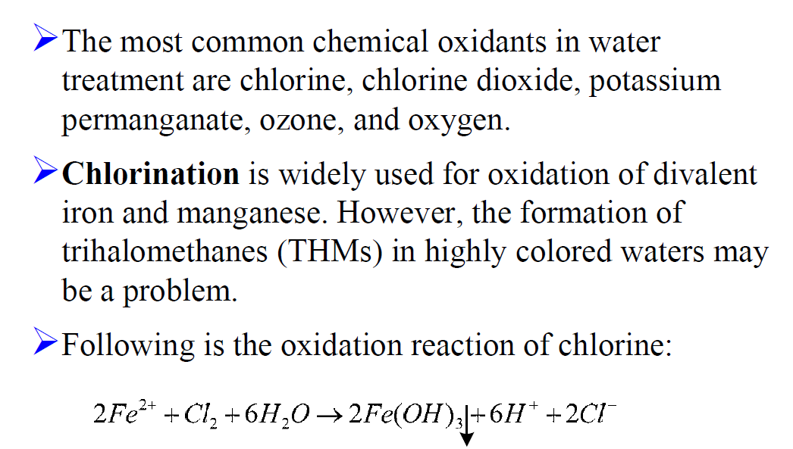
Treatment methods
Fe and Mn removal (cont.)

Slide 9
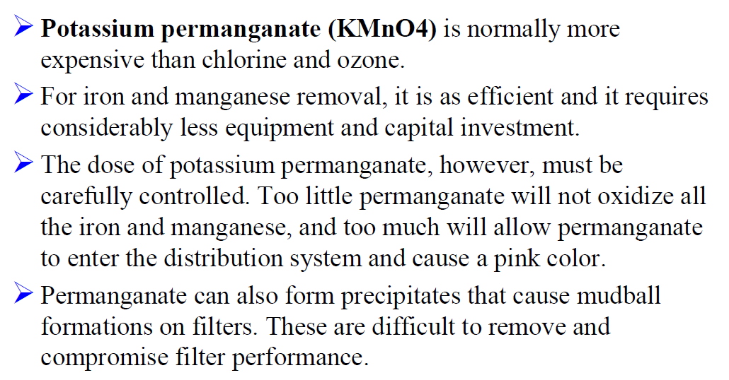
Treatment methods
Fe and Mn removal (cont.)

Slide 10
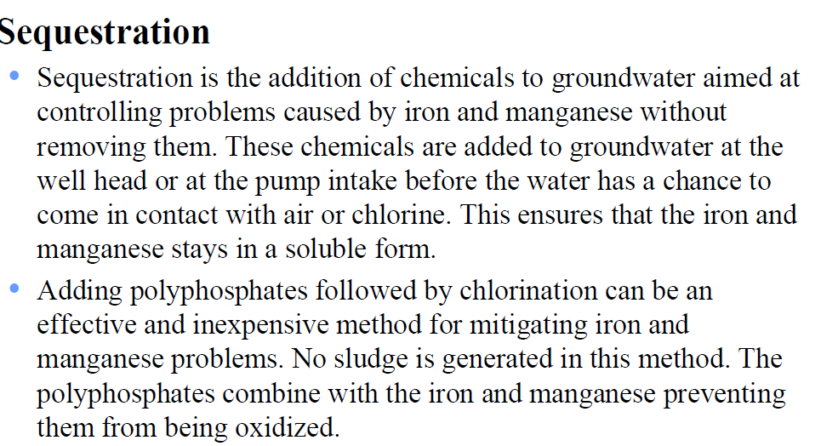
Treatment methods
Fe and Mn removal (cont.)

Slide 11
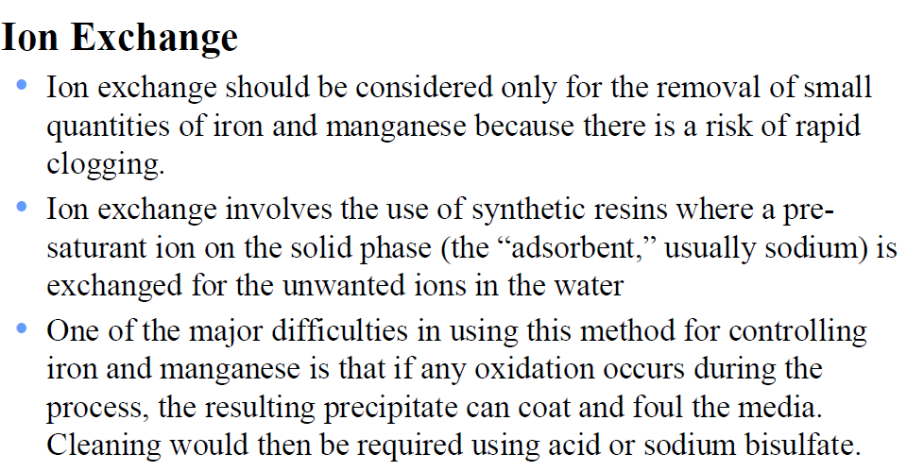
Treatment methods
Fe and Mn removal (cont.)

Slide 12
Treatment methods
Fe and Mn removal (cont.)
Removal of Fe and Mn using aeration
A low-cost method of providing oxidation is to use the oxygen in air as the oxidizing agent in a tray aerator.
Water is simply passed down a series of porous trays to provide contact between air and water.
Oxygen is not a strong enough oxidizing agent to break the strong complexes formed between iron and manganese and large organic molecules.
Furthermore, the rate of reaction between oxygen and manganese is very slow below pH values of 9.5.

Slide 13
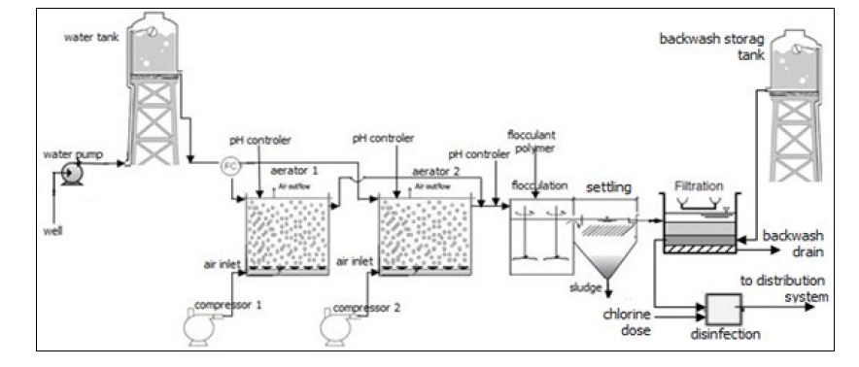
Proposed treatment system for Fe and Mn removal

Slide 14
Components of the proposed treatment system
Two completely mixed flow aeration tanks operated in series.
Addition of a flocculent chemical in a Flocculator with a slow mix device.
Plate settling tank (Lamella type) for fast separation of solids formed from oxidation reaction.
Dual media sand filter equipped with backwashing system.
Suitable disinfection system (chlorination).

Slide 15
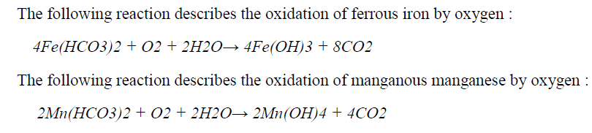
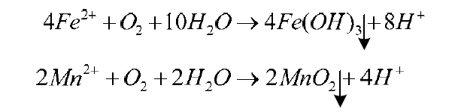
Oxidation reactions involved in the aeration

Slide 16
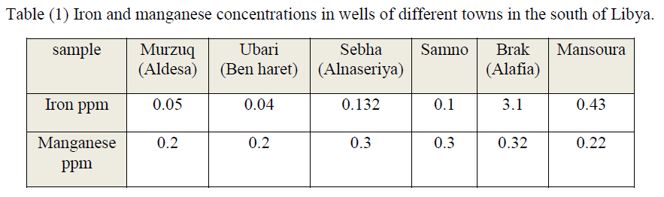
Fe and Mn concentrations in GW
The standards set by the World Health Organization WHO, for concentrations of Fe & Mn are 0.3, and 0.1 mg /L respectively .

Slide 17

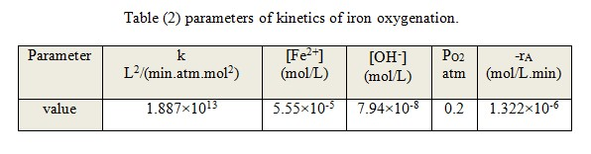
Important design parameters
Kinetics of Fe oxidation RXN

Slide 18
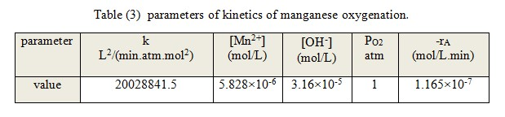
Important design parameters
Kinetics of Mn oxidation RXN

Slide 19
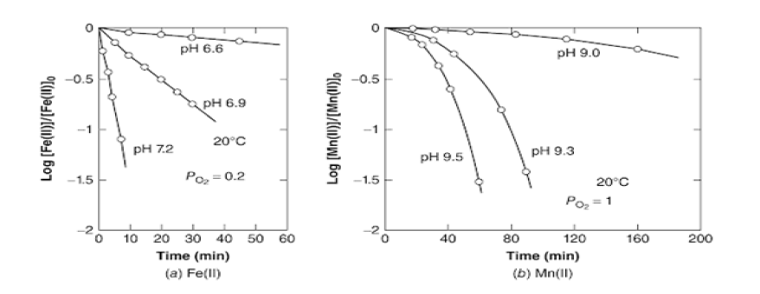
Important design parameters
Impact of pH on Fe & Mn removal

Slide 20
Selected GW source city of AL-Afia Brak Shati & Design data requirements
Item | Value
population | 4500 inhabitants
Rate of water consumption | 140 L/ person-day
City GW consumption | 630000 L/day ( 630 m3/day)
Flow rate to CMFR 1 | 110.0 L/min
Flow rate to CMFR 2 | 327.5 L/min
Water Conditions | T= 20 C & P= 1 atm
Partial pressure of oxygen | 0.2 atm for Fe & 1 atm for Mn
Fe & Mn conversion | 90 %
PH for Fe reaction 42 min aeration | 6.9
PH for Mn reaction 50 min aeration | 9.5

Slide 21
Selected GW source city of AL-Afia Brak Shati & Design data requirements (cont.)
Total oxygen required for both Fe & Mn | 5.5268 mg/L
Density of air at water conditions | 1.205 g/L
Amount of air to tank 1 | 2.4 L/min
Amount of air to tank 2 | 7.5 L/min
Compressed air efficiency | (10 – 15 ) %
Compressed air pressure | (35 – 70) kN/m2

Slide 22
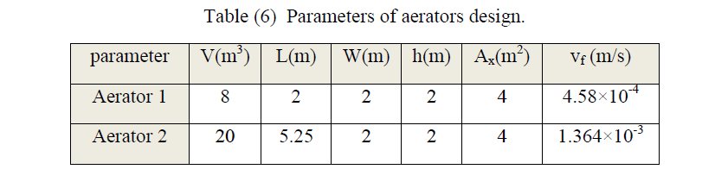
CMF Aeration design results

Slide 23
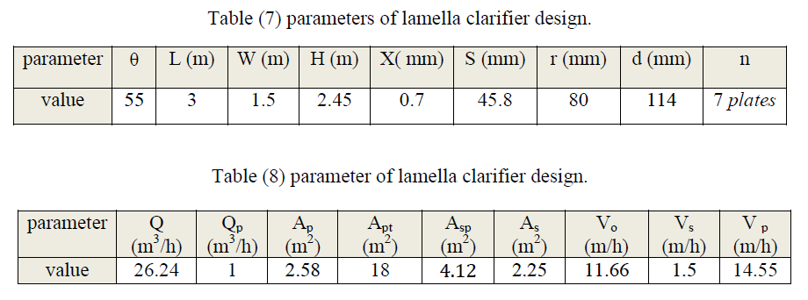
Settling tank (lamella) design results

Slide 24
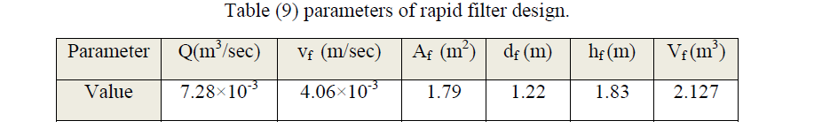
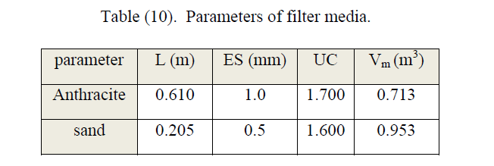
Rapid sand filter design results

Slide 25
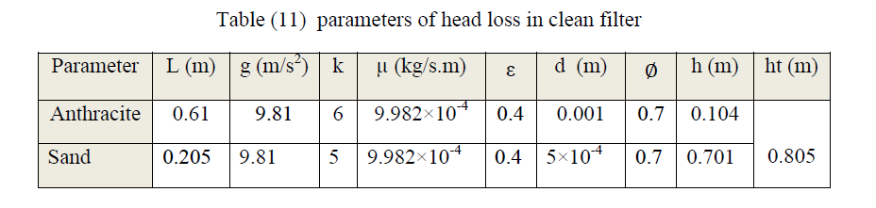
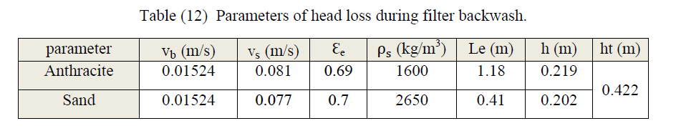
Rapid sand filter design results (cont.)

Slide 26
Conclusions
Aeration of GW can effectively remove iron and manganese to a level accepted by local and international standards.
When manganese is available in GW at higher concentrations, it is important that the water treatment process is well monitored to ensure the removal of Fe and Mn are within the acceptable levels.
Manganese requires larger amount of oxygen for oxidation during aeration as compared to iron.
Iron is easily oxidized than manganese during aeration.

Slide 27
Conclusions
Conclusions (cont.)
Longer retention time may be required for the removal of manganese if aeration and filtration are applied in the water treatment process.
The pH adjustments need to be carefully monitored after oxidation of iron and manganese because pH may affect the floc formation and removal during the water treatment.
The pH value of the effluent treated GW need to be adjusted to a level (6 – 8), below this level is believed to cause iron and manganese flocs formed to re-dissolve in water.

Slide 28
Recommendations
Proposed GW treatment system for iron and manganese removal need to be tested through a pilot scale study before any field application.
Further studies need to be conducted on GW that contains higher levels of Fe and Mn, Ammonium salts and natural organics matter because might have dissolved oxygen deficit.
An economic study for the proposed GW treatment system for iron and manganese removal is essential for field applications in order to get cost of treatment per cubic meter.

Slide 29

Thanks

