Slide 1


Slide 2
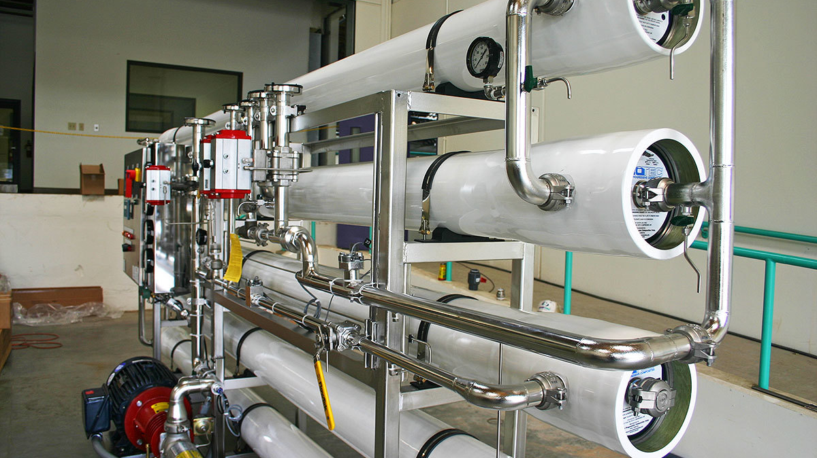
Reverse Osmosis

Slide 3
Content :
Pre-treatment for RO
How does Reverse Osmosis work?
What will Reverse Osmosis remove from water?
Water Quality Comparisons
the difference between a 1 and 2 stage RO System
The difference between a single pass and a double pass RO system

Slide 4
Pre-treatment for RO:
Flocculation
Lime Softening
Decarbonization (Ion Exchange)
Softening
Filtration
Ultrafiltration

Slide 5
Filters
Microfiltration And Ultrafiltration Systems
What does microfiltration remove?
MF membranes are available in pore sizes ranging from 0.1 to 10 μm.
MF porosity is the highest in the membrane filtration family, with the result that MF membranes allow water, ions, dissolved organic material, small colloids, and viruses to pass through, while retaining larger contaminants such as:
•Algae
•Bacteria
•Pathogenic protozoa
•Sediment, including sand, clay, and complex metals/particles

Slide 6
What does ultrafiltration remove?
UF membranes are available in pore sizes ranging from 0.1 to 0.001 μm. Owing to the smaller pore size of its membranes, UF removes a more comprehensive range of contaminants than MF does, while leaving behind ions and organic compounds of low molecular weight. UF is suited for removal of very fine particles, including:
•Endotoxins
•Plastics
•Proteins
•Silica
•Silt
•Smog
•Viruses

Slide 7
How does MF/UF work?
MF and UF physically separate solids from liquid streams based on the principle of size-exclusion. As a feed stream is passed through the MF/UF membrane, any solids that are too large to pass through the membrane’s pores are retained, while any liquid or small particles are permitted to flow through. In either MF or UF, the portion of the feed stream that has passed through the filter membrane is referred to as the filtrate or permeate, while the remainder is known as the retentate.

Slide 8
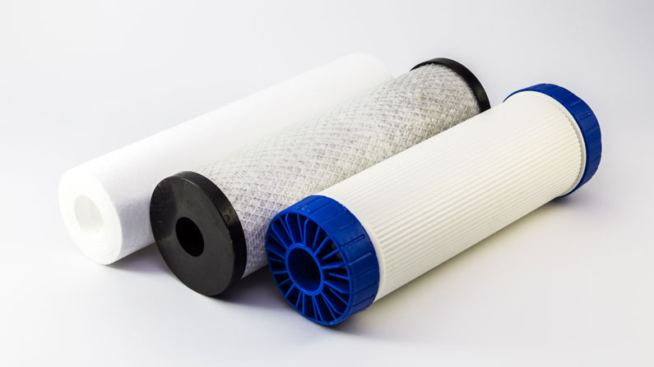
What Is Filter Cartridge?
Filter Cartridge is considered the heart of filter; it is inserted inside the housing and used to remove the contaminant/particles from water.

Slide 9
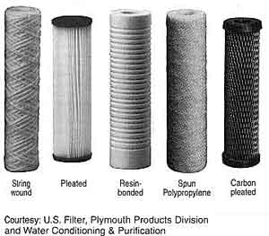
What Are Different Types Of Filter Cartridge
Polypropylene Spun filter cartridge
Polypropylene wound filter cartridge
Polypropylene Pleated filter cartridge
PTFE polytetrafluorethylene
pleated filter cartridge
Resin bonded filter cartridge
Stainless steel filter cartridge

Slide 10
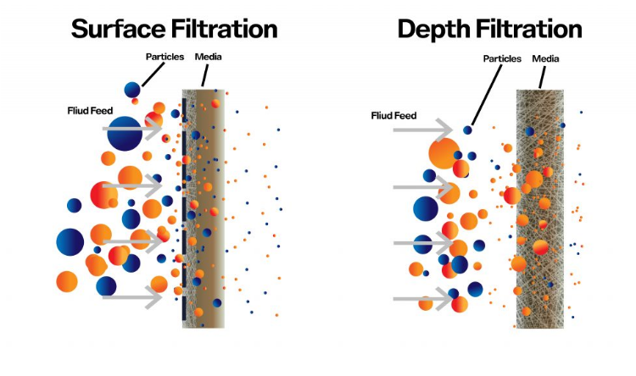
What Are The Two Categories Of Cartridge Filter?
a) surface filters
b) depth filters.

Slide 11

Osmosis is a process where a weaker saline solution will tend to migrate to a strong saline solution.
Reverse osmosis is the process of osmosis in reverse. whereas osmosis occurs naturally without energy required, to reverse the process of osmosis you need to apply energy to the more saline solution. a reverse osmosis membrane is a semi permeable membrane that allows the passage of water molecules.

Slide 12
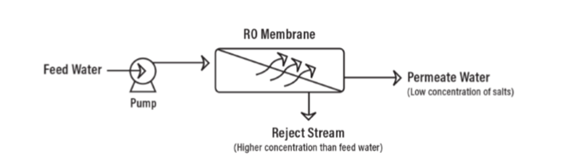
How does Reverse Osmosis work?
The amount of pressure required depends on the salt concentration of the feed water.
feed water : good water and bad water.
The ‘bad’ water is the water that contains all the contaminants that were unable to pass through the RO membrane and is known as the concentrate, reject, or brine. Permeate is the water that was pushed
through the RO membrane
and contains very little
contaminants.

Slide 13
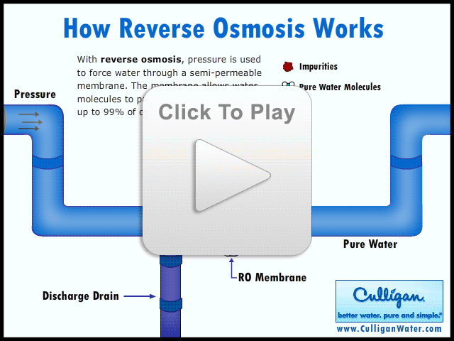

Slide 14
What will Reverse Osmosis remove from water?
Reverse Osmosis can remove 95-99% of the dissolved salts (ions), particles, colloids, organics, bacteria, and pyrogens from the feed water. An RO membrane rejects contaminants based on their size and charge.
Because an RO system does not remove gases, the permeate water can have a slightly lower than normal pH level depending on CO2 levels in the feed water as the CO2 is converted to carbonic acid.

Slide 15
Water Quality Comparisons
RO TREATED ONLY
30 ppm TDS
REVERSE OSMOSIS
600 ppm TDS
FEEDWATER
DEMIN TREATED ONLY
6 ppm TDS
CATION EXCHANGER
ANION EXCHANGER
RO + DEMIN TREATED
<1 ppm TDS
REVERSE OSMOSIS
CATION EXCHANGER
ANION EXCHANGER
SOFTENER + RO TREATED
30 ppm TDS
FILTER
SOFTENER
REVERSE OSMOSIS

Slide 16
Size Range Of Solids vs Separation Process
Suspended
Colloidal
Dissolved
Floc
Algae
Turbidity
Bacteria
Colloidal clay
Color
Virus
Molecules/Atoms
Visible
Invisible
Gravel
Conventional filtration
Coarse sand
Human hair
Ultrafiltration
Silt
Carbon black
Microfiltration
Reverse Osmosis
Polio virus
10⁴
10³
10²
10¹
10⁰
10⁻¹
10⁻²
10⁻³
10⁻⁴
10⁻⁵
Microns

Slide 17
REVERSE OSMOSIS
Filtration - spectrum
by: OSMONICS INC.
elektronscan-microsc.
optical microscope
directly visible
ionic-range
molecular-range
macromolekuls
microparticle
macroparticle-range
µm (log.scale)
0,001
0,01
0,1
1,0
10
100
1000
approx.
atomic weight
100
200
20.000
500.000
aqu. salts
black pigments human hair
carbon
common
materials
pyrogenes yeast cells mist
metal-ions virus b a c t e r i a fine-sand
sugars colloids m i l l e d f l o u r
atomic radii albumins p o l l e n s
process
for
separation
reverseosmosis
microfiltration
ultrafiltration
particle filtration

Slide 18
Types of Crossflow Membrane-Filtration
 | Microfiltration | Ultrafiltration | Nanofiltration | Reverse Osmosis
Range | macro molec. | Molecular | sub molecular | Ionic
Particle size [ Microns] | 1.0 - 0.1 | 0.1 - 0.01 | 0.01 - 0.001 | < 0.001
Removes | Susp. solids Large colloids Bacteria | Proteins Colloids Organics | Pyrogens Divalent ions Virus | Small organics Metals Salts
Molecular Weight | >100,000 | 10,000 – 100,000 | 200 - 20,000 | < 300
Operating Pressure | 60 kPa | 60-600 kPa | 1350-1750 kPa | 1350-5550 kPa
Pretreatment needs | Low | Medium | High | High
Capital Cost | Low | Medium | High | High

Slide 19
the difference between a 1 and 2 stage RO System
Difference between a 1 and 2 stage RO System In a one stage RO system, the feed water enters the RO system as one stream and exits the RO as either concentrate or permeate water.
In a two-stage system the concentrate (or reject) from the first stage then becomes the feed water to the second stage. The permeate water is collected from the first stage is combined with permeate water from the second stage. Additional stages increase the recovery from the system.

Slide 20
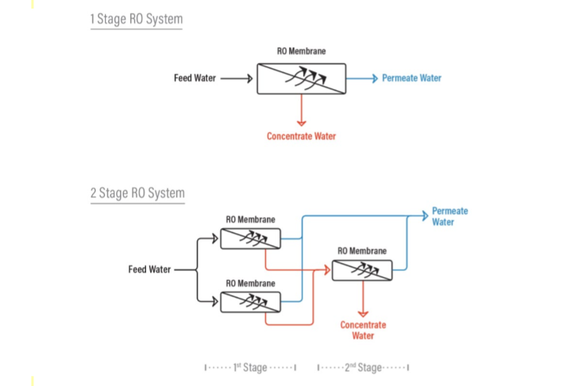

Slide 21
The difference between a single pass and a double pass RO system
The difference between a single pass RO system and a double pass RO system is that with a double pass RO, the permeate from the first pass (first RO) becomes the feed water to the second pass (or second RO) which ends up producing a much higher quality permeate because it has essentially gone through two RO systems.
The double pass system also allows the opportunity to remove carbon dioxide gas from the permeate by injecting caustic between the first and second pass. C02 is undesirable when you have mixed bed ion exchange resin beds after the RO. By adding caustic after the first pass, you increase the pH of the first pass permeate water and convert C02 to bicarbonate (HCO-) and carbonate (CO-2) for better rejection by the RO membranes in the second pass.

Slide 22
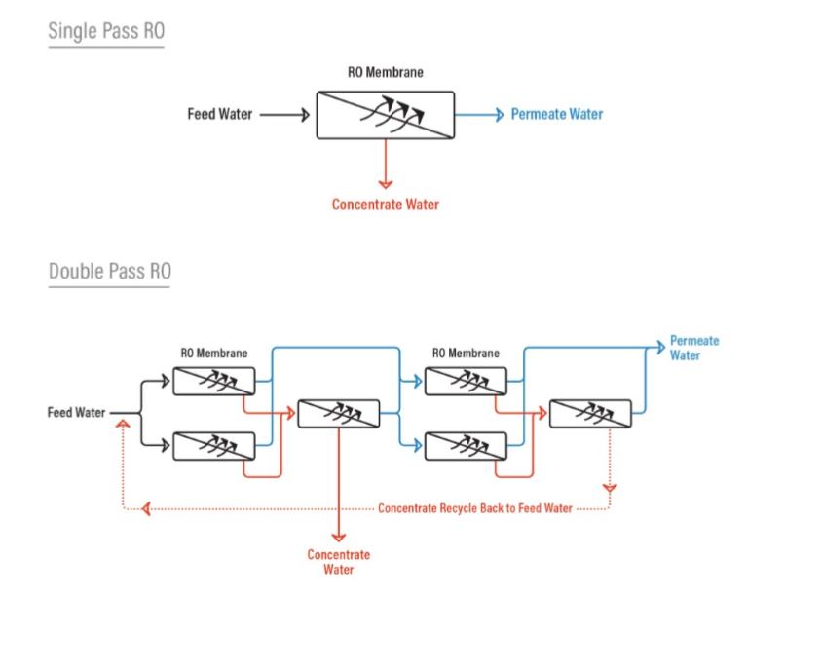

Slide 23

REVERSE OSMOSIS
basic terms
PERMEATE
or PRODUCT
FEEDWATER
100 %
75% Recovery
30 ppm TDS
600 ppm TDS
5% Salt Passage
CONCENTRATE
or REJECT
or BRINE
25% Concentrate
2310 ppm TDS
95% Salt Rejection

Slide 24

Calculations
Recovery %
Recovery is the amount of water that is being ‘recovered’ as good permeate water.
% Recovery$=\frac{Permeate Flow Rate (gpm)}{Feed Flow Rate (gpm)}$x100
if the recovery rate is 75% then this means that for every 100 gallons of feed water that
enter the RO system, you are recovering 75 gallons as usable permeate water and 25 gallons are going to drain as concentrate. Industrial RO systems typically run anywhere from 50% to 85% recovery depending on the feed water characteristics and other design considerations.

Slide 25

Concentration Factor
the concentration factor is related to the RO system recovery and is an important equation for RO system design. The more water you recover as permeate (the higher the % recovery), the more concentrated salts and contaminants you collect in the concentrate stream. This can lead to higher system design. The more water you recover as permeate (the higher the % recovery), the more concentrated salts and contaminants you collect in the concentrate stream. This can lead to higher potential for scaling on the surface of the RO membrane when the concentration factor is too high for the system design and feed water composition.
Concentration Factor$=\frac{1}{(1−Recovery \%)}$

Slide 26
Recovery vs. Concentration Factor
Recovery | Concentration Factor
50% | 2
75% | 4
80% | 5
90% | 10
95% | 20
97.5% | 40
98%` | 50

Slide 27

Flux
Flux is used to express the amount of water that passes (permeates) through a reverse osmosis membrane during a given time - gallons per square foot per day (GFD) or liters per square meter per hour (l/m2/hr).a higher flux means more water is permeating through the RO membrane. RO systems are designed to operate within a certain flux range to ensure the water flowing through the RO membrane is not too fast or slow.
GFD$=\frac{gpm of permeate x 1,440 min/day}{\# of RO elements in system x square footage of each ROelement }$

Slide 28
Mass Balance
A Mass Balance equation is used to help determine if your flow and quality instrumentation is reading properly or requires calibration. If your instrumentation is not reading correctly, then the performance data trending that you are collecting is useless.
You will need to collect the following data from an RO system to perform a Mass Balance calculation:
1. Feed Flow (gpm)
2. Permeate Flow (gpm)
3. Concentrate Flow (gpm)
4. Feed Conductivity (µS)
5. Permeate Conductivity (µS)
6. Concentrate Conductivity (µS)
The mass balance =(Feed flow1 x Feed Conductivity) = (Permeate Flow x Permeate Conductivity) +
(Concentrate Flow x Concentrate Conductivity)
Feed Flow = Permeate Flow + Concentrate Flow

Slide 29
For example, if you collected the following data from an RO system:
Permeate Flow 5 gpm
Feed Conductivity 500 µS
Permeate Conductivity 10 µS
Concentrate Flow 2 gpm
Concentrate Conductivity 1200 µS
Then the Mass Balance Equation would be: (7x500) = (5 x 10) + (2x1200)
3,500 ≠ 2,450
Then find the difference: (Difference / Sum) x 100 = 18%
A difference of +/- 5% is ok. A difference of +/-- 5% to 10% is generally adequate. A difference of > +/-10% is unacceptable and calibration of the RO instrumentation is required to ensure that you are collecting useful data. In the example above, the RO mass balance equation falls out of range and requires attention

Slide 30
Net Differential Pressure
Δ
P
= P_{f} - P_{c}
Δ
P
differential pressure, “delta P” or pressure drop
P_{f} = feed pressure
P_{c} = concentrate pressure
Notes:
12

Slide 31
Net Driving Pressure (NDP)
Feed
Permeate
Applied Pressure, P_{F}
Permeate Pressure, P_{P}
Osmotic Pressure, P_{O,F}
Osmotic Pressure, P_{O,P}
NDP
Notes:
Reverse osmosis occurs when a force in excess of the osmotic pressure is applied to the stronger solution which causes the water to to permeate through the membrane from the stronger to the weaker solution.

Slide 32
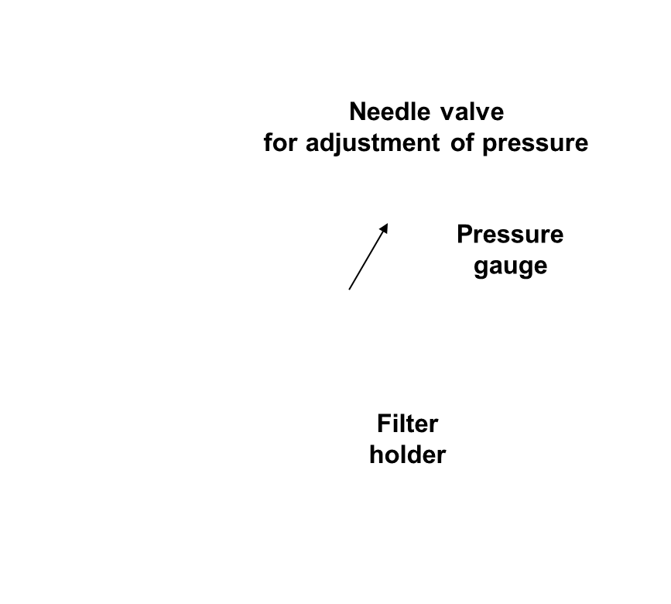
Silt Density Index (SDI)
a standard method to determine the fouling potential of RO feed
Comparison between the times for filtering water over a membrane- filter at start-up conditions ( = clean filter ) versus after 15 minutes of operation

Slide 33
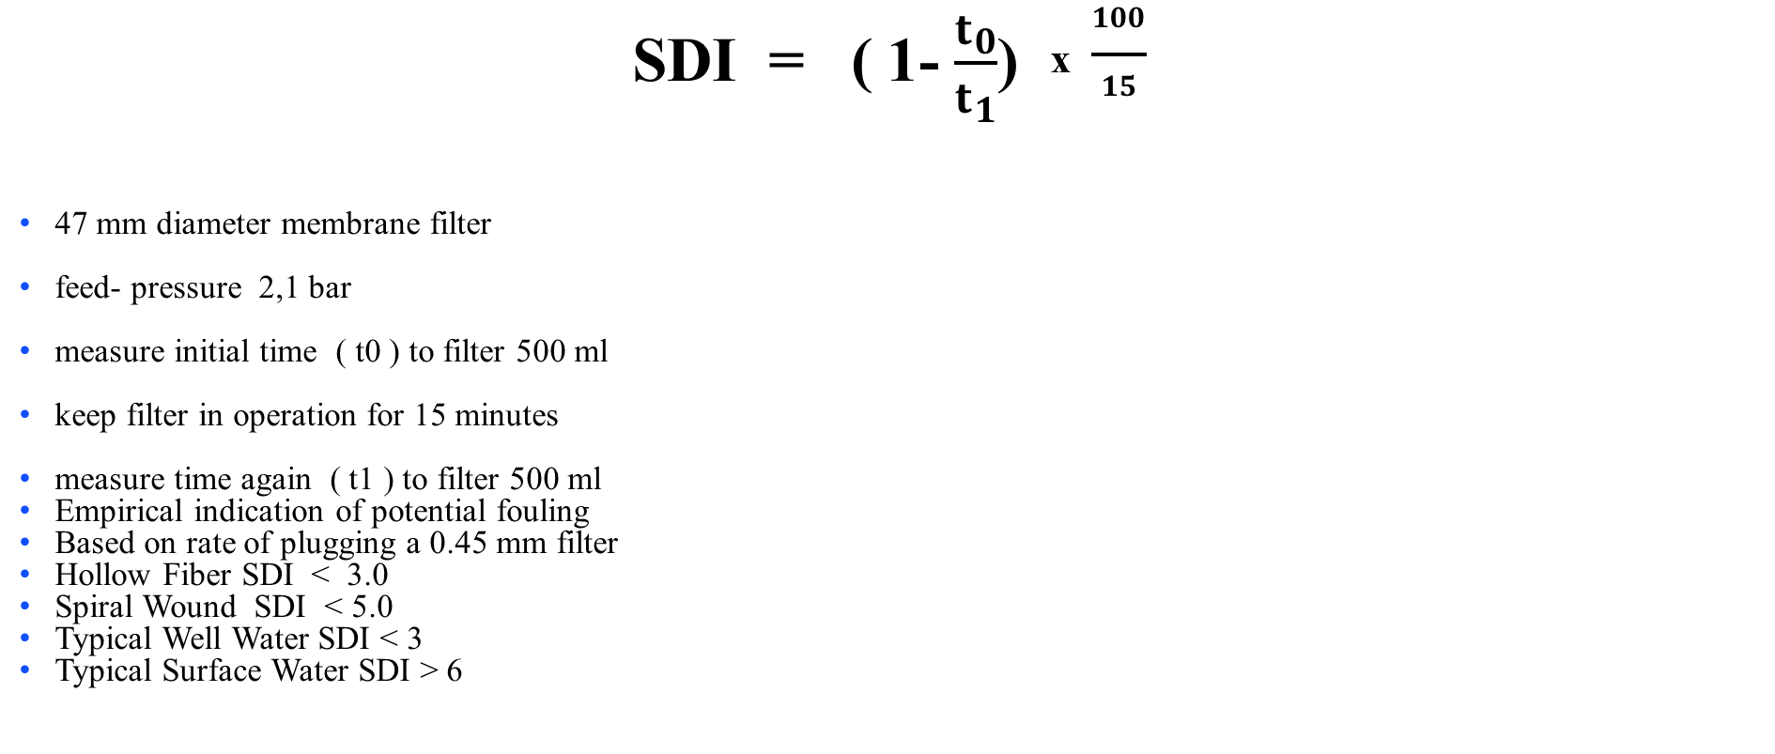
Silt Density Index (SDI)
SDI = ( 1- $\frac{t_{0}}{t_{1}}$) ^{x} $\frac{100}{15}$
47 mm diameter membrane filter
feed- pressure 2,1 bar
measure initial time ( t0 ) to filter 500 ml
keep filter in operation for 15 minutes
measure time again ( t1 ) to filter 500 ml
Empirical indication of potential fouling
Based on rate of plugging a 0.45 mm filter
Hollow Fiber SDI < 3.0
Spiral Wound SDI < 5.0
Typical Well Water SDI < 3
Typical Surface Water SDI > 6

Slide 34
Langelier Saturation Index (LSI)
The Langelier Saturation Index is a water quality parameter used to determine the tendency of water to form calcium carbonate scaling. It measures the degree of saturation and is determined by calculating the difference between the actual and the theoretical pH of the water.
LSI = pH – pHs
Where:
LSI = Langelier Saturation Index
pH = Actual pH of the water
pHs = Calculated theoretical pH of the water based on chemical analysis

Slide 35
Factors Must Be Taken Into Consideration During The Design Process
I. Water Source: By pre-treating the feed-water
II. Temperature and Flow Rate: The temperature of the water has a significant impact on the flux rate, or the rate at which water flows through a membrane. Temperature and flow rate characteristics must be considered when designing a reverse osmosis system and pretreatment equipment.
III. Pretreatment: To prevent scaling from calcium and magnesium carbonates, feed-water should be prepared with a caution exchange water softener or chemical antiscalant, depending on the water hardness level.
IV. Silt Density Index: To avoid inefficiency and downtime, feed-water should be evaluated in the field using a silt density index test (SDI) before designing pre-treatment for reverse osmosis systems. If the feed-water contains significant amounts of silt, flocculent treatment upstream of multimedia filtration may be required.

Slide 36
system design
Small commercial systems utilize 2.5” and 4” diameter membranes. The membranes are typically housed in polyvinyl chloride (PVC) or stainless steel single membrane housings and installed in a vertical configuration. There may be some PVC or stainless steel piping, but hoses are typically used to connect the RO housings. This reduces the cost of the materials and assembly time. In commercial systems, the instrumentation is basic. Depending on the manufacturer, there are usually permeate and concentrate flow rotameters with a concentrate pressure gauge and a motor starter.
a preprogrammed microprocessor is used to start and stop the RO system, based on product level in the permeate storage tank. The microprocessors also have “pretreatment lockout” to prevent the RO system from running if a media filter is in backwash or softener is in regeneration. Pump low and high pressure protection is included for additional cost.

Slide 37
Pretreatment of commercial systems should include a multimedia filter, softener and activated carbon filter. The back washable filter and softener vessels are fibre glass reinforced plastic (FRP) with a timer-based control valve. The RO system should include a “Big Blue” style plastic housing with pre-filter rated at five microns and a 304 stainless steel multistage pump. A stainless steel needle valve is used to control concentrate flow, and permeate flow varies. Depending on the manufacturer, some parts may be brass rather than stainless steel. This design is based on competitive price pressures and low cost of the RO membranes.
The commercial system design is controlled by the price. If the purchaser is educated to the benefits, concentrate recirculation, pre-filter inlet and outlet pressure gauges, pump throttling valve, soft motor starter or variable frequency drive, FRP vessels, so called “cold water” membranes and permeate pressure gauges can be included.

Slide 38
The commercial RO permeate flow rating is usually close to the maximum allowable of the RO membrane manufacturer, rather than based on the application and membrane flux. Recoveries are 20% to 50% without concentrate recirculation or as high as 75% with concentrate recirculation.
Since the feed water flow rate drops as permeate passes across the membrane, it becomes concentrated with high scaling and fouling containments the further across the membrane surface it flows. In order to minimize the fouling or scaling of the concentrate containments, a minimum flow is required to maintain high velocity and turbulence on the membrane surface. The concentrate recirculation option allows higher recoveries and less wastewater, by mixing feed water with rejected concentrate water.

Slide 39
Design of large reverse osmosis systems
With large systems, many RO membranes are used and the cost of the membranes is significant. Therefore, higher end “heavy industrial” and municipal reverse osmosis systems have a different design philosophy than their smaller commercial counterparts.
A small reverse osmosis unit.
The cost of the system is important, but greater weight is placed on the longer-term operation and maximum membrane life and performance. The 2.5” and 4” membranes cost between $100 to $350 and there are very few membranes on the system. So the membranes are regarded as disposable and replaced every year or two, even though the performance may have been degrading over time.
In industrial systems, there are multiple 8” membranes ranging from 18 to 180 per skid with six long vessels, and each membrane typically costs $600 to $800. Reliable performance in salt rejection and flow are critical for heavy industrial users. Often, the RO water is further polished by electrodeionization (EDI) to achieve ultrapure grade water without chemical regeneration.

Slide 40

Thank you

